Slide 1
Statistical Learning
Diamonds Dataset
Project Work By:
Davide Gamba, Matr. 1053470
Aurora Zanenga, Matr. 1054891

Slide 2
Diamonds Dataset
Variable Name | Description | Variable Type
PRICE | Price in US dollars ($326-$18.823) | Continuous
CARAT | Weight of the diamond (0.2--5.01) | Continuous
CUT | Quality of the cut (Fair, Good, Very Good, Premium, Ideal) | Categorical
COLOR | Diamond color, from J (coloured, worst) to D (colorless, best) | Categorical
CLARITY | Refers to how clear the material is and what surface imperfections it may have (I1 (worst), SI2, SI1, VS2, VS1, VVS2, VVS1, IF (best)) | Categorical
X | Length in mm (0--10.74) | Continuous
Y | Width in mm (0--58.9) | Continuous
Z | Depth in mm (0--31.8) | Continuous
DEPTH % | Is the depth of the diamond divided by the diameter of the diamond (43%--79%) | Continuous
TABLE % | Is the length of the table facet divided by the diameter of the diamond(43%--95%) | Continuous

Slide 3
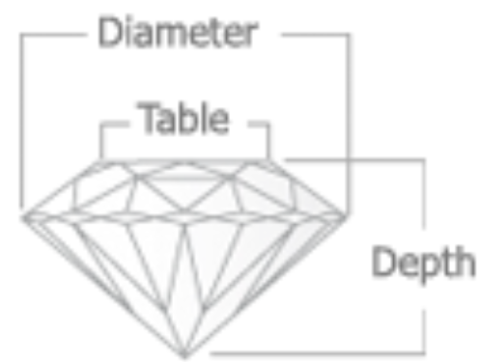
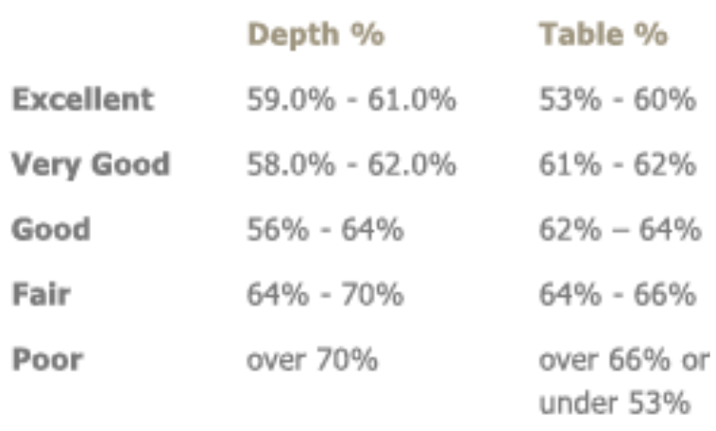
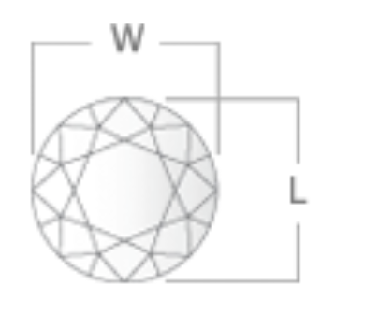
Context

Slide 4
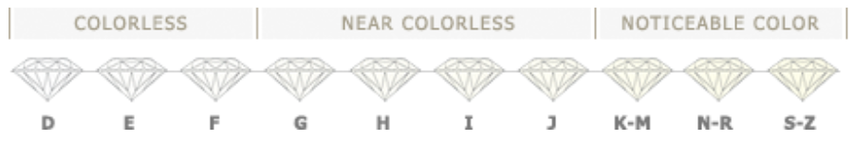
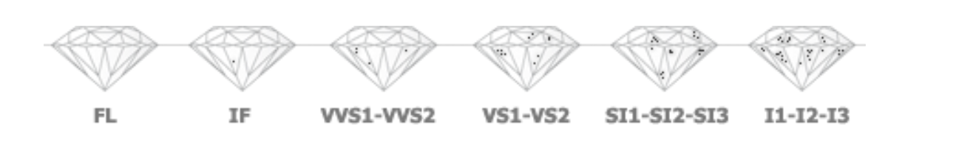
Context

Slide 5
Goals
Which models can most efficiently predict price?
The relationship between features and price is linear?
Which are the variables that have the greatest influence on price?

Slide 6
preprocessing steps
Check for null columns or elements.
Redefining the dataset into a range from 2000$ to 8000$.
Converting prices in thousands dollars.
Categorical variables into factors.
Removing outliers.
From 50.000 to 20.000 observations.
Splitting the dataset in training set and test set (70% - 30%).

Slide 7
Variables Analysis
 | Unit of Measure | Mean | Std_dev
Carat | Unit | 0.9396 | 0.2189
Depth_Percentage | % | 61.8425 | 1.2497
Table | % | 57.6094 | 2.0321
Price | Thousand $ | 4.3114 | 1.5983
Length | mm | 6.2356 | 0.4940
Width | mm | 6.2368 | 0.4853
Depth | mm | 3.8562 | 0.3063

Slide 8
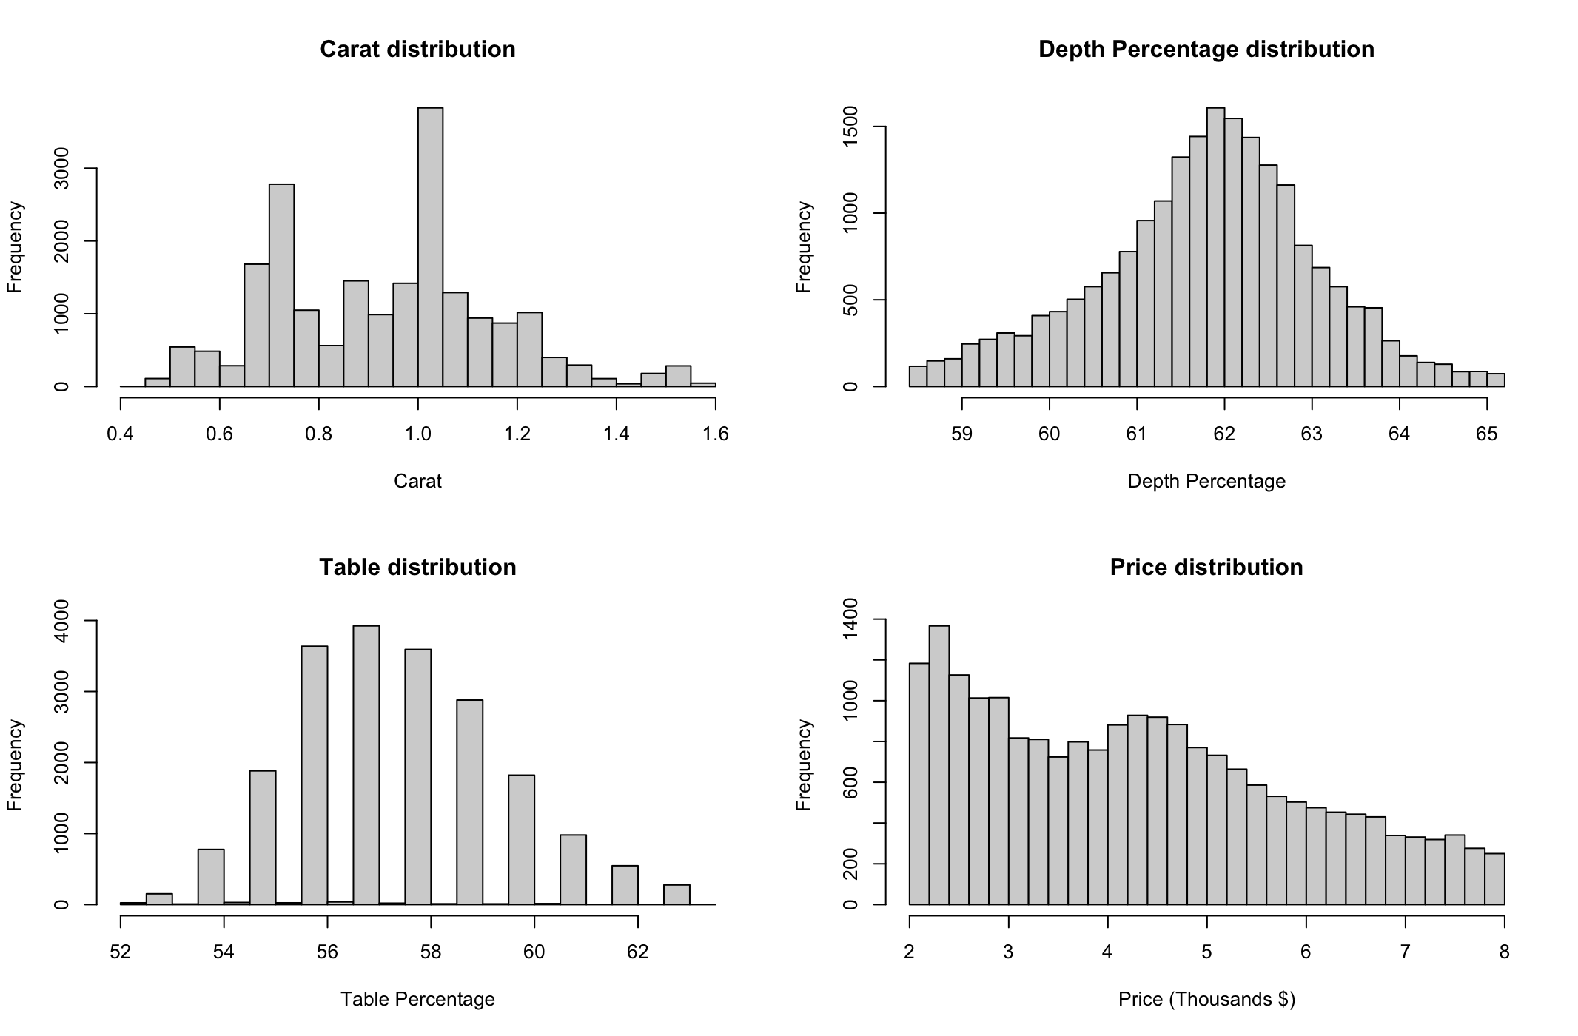
Variables distribution

Slide 9
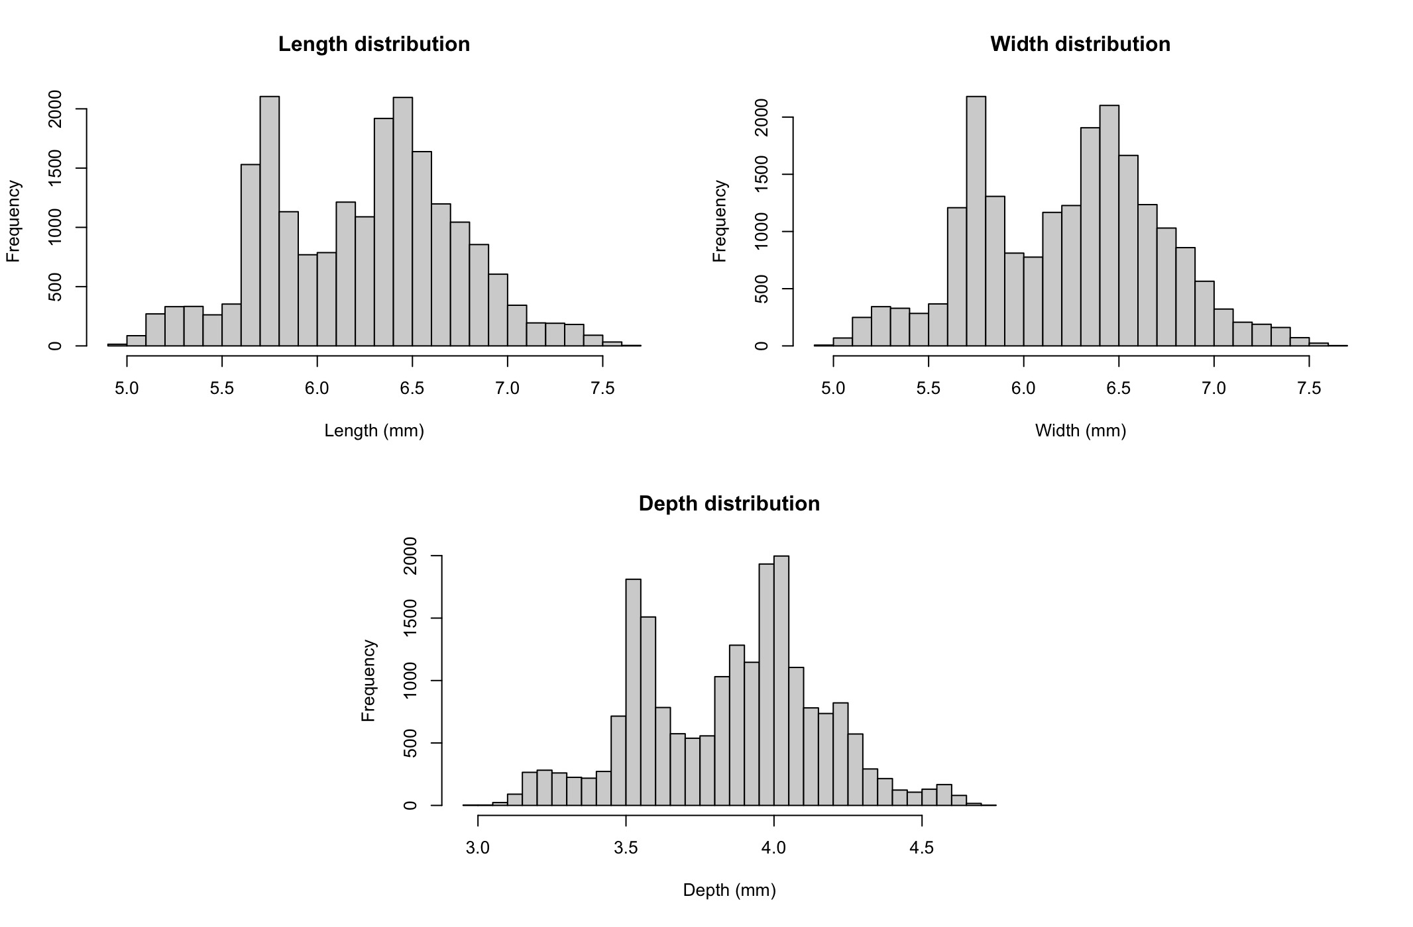
Variables distribution

Slide 10
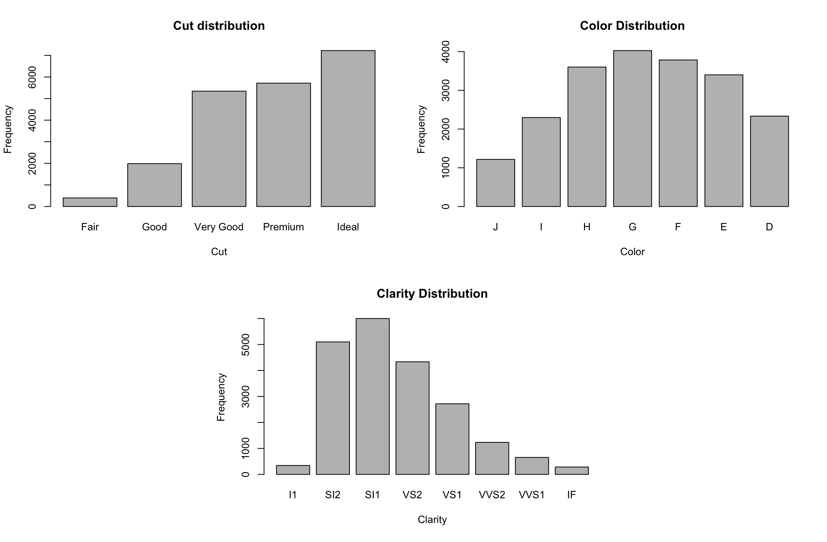
Variables distribution

Slide 11
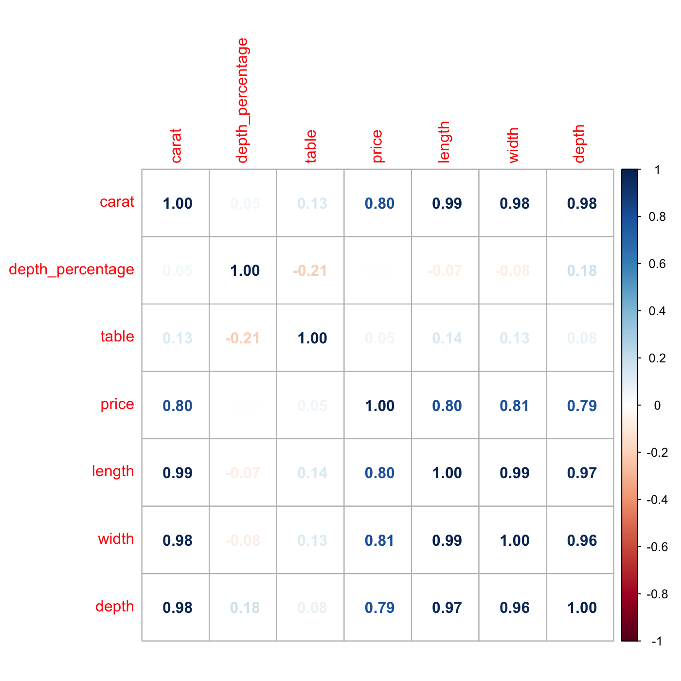
Correlation matrix

Slide 12
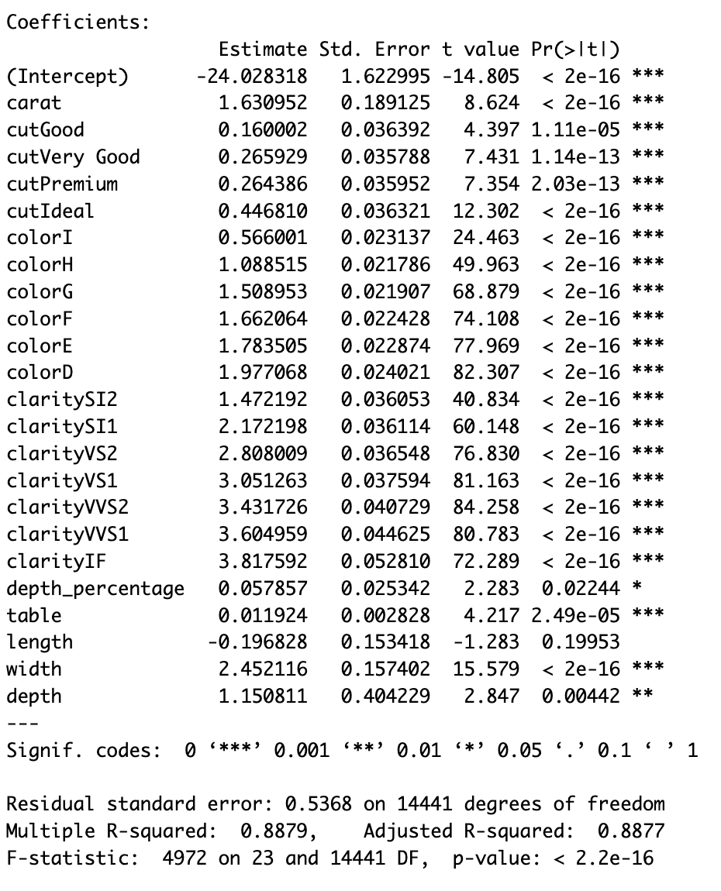
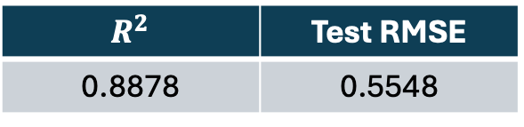
Linear regression
It shows how significant the coefficients are.
$$R^{2}$$ | Test RMSE
0.8878 | 0.5548

Slide 13
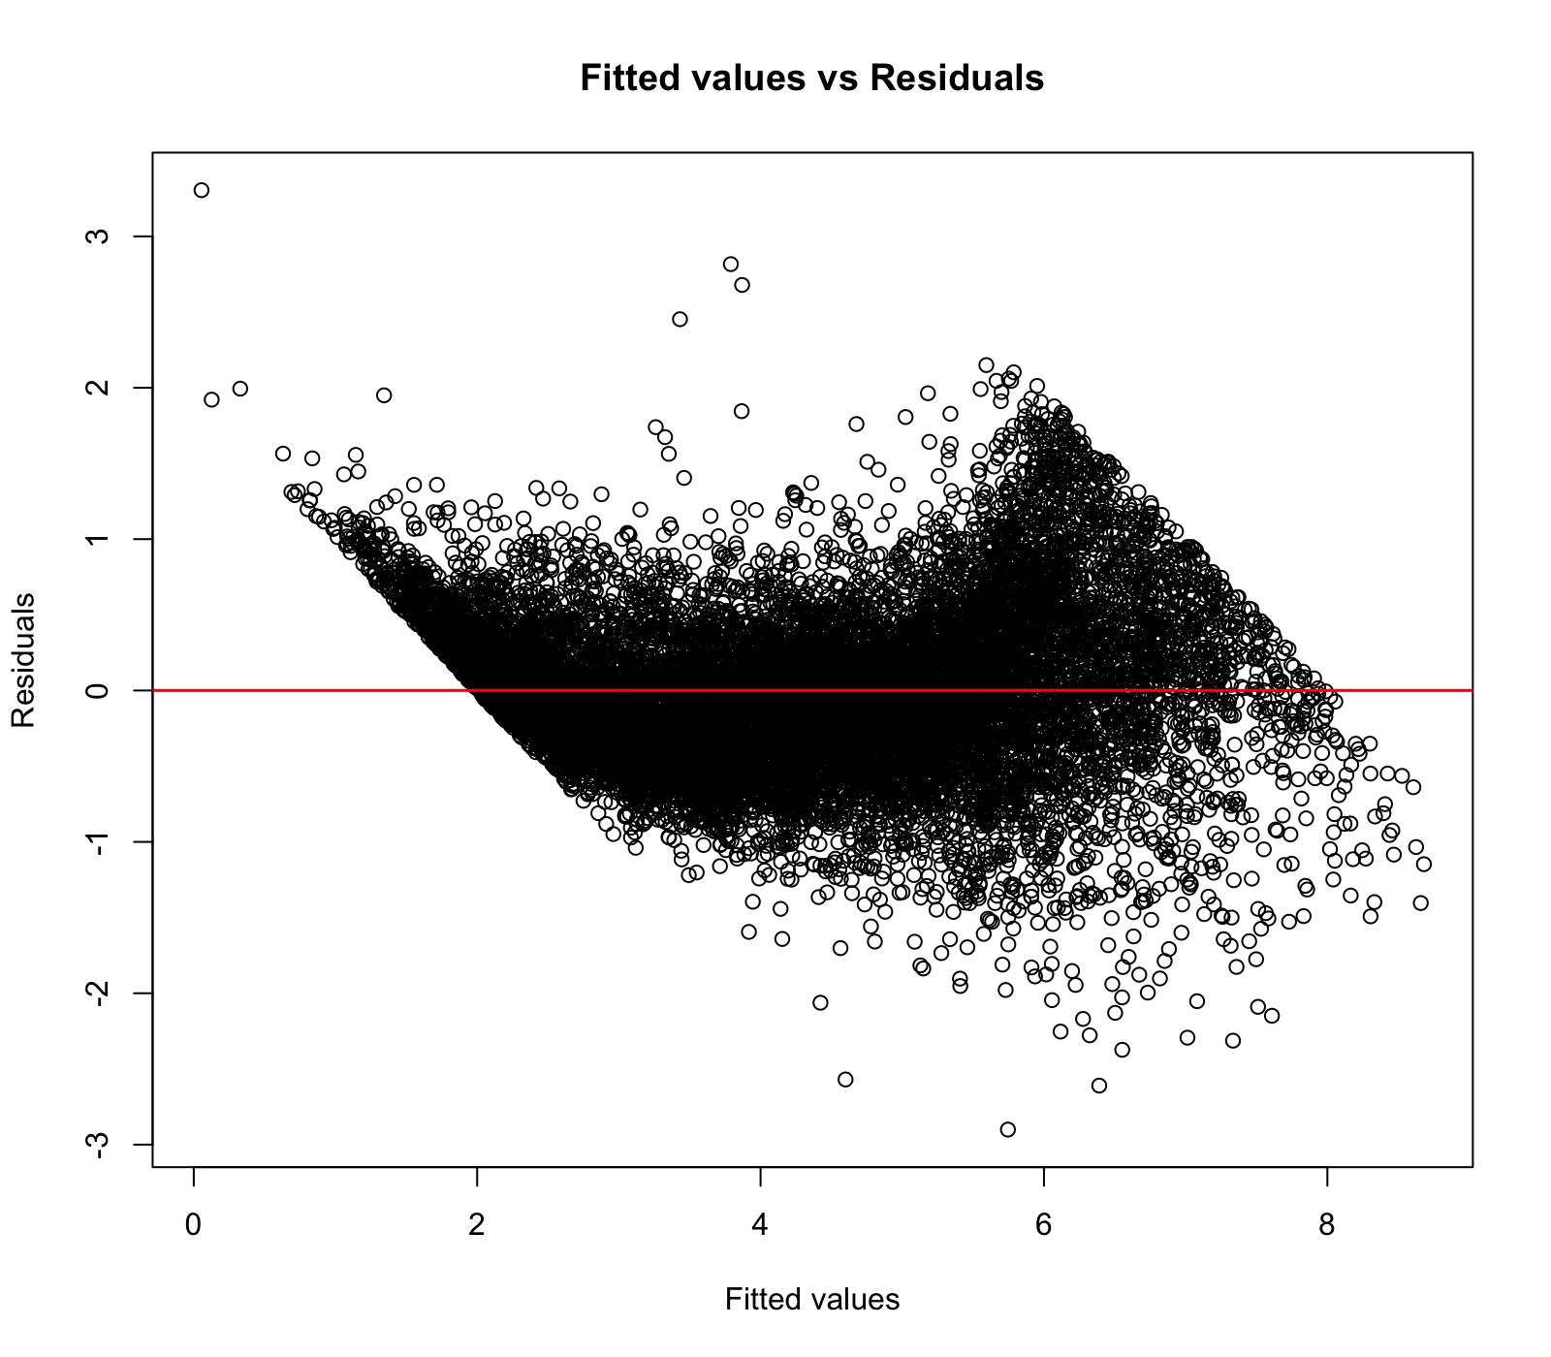
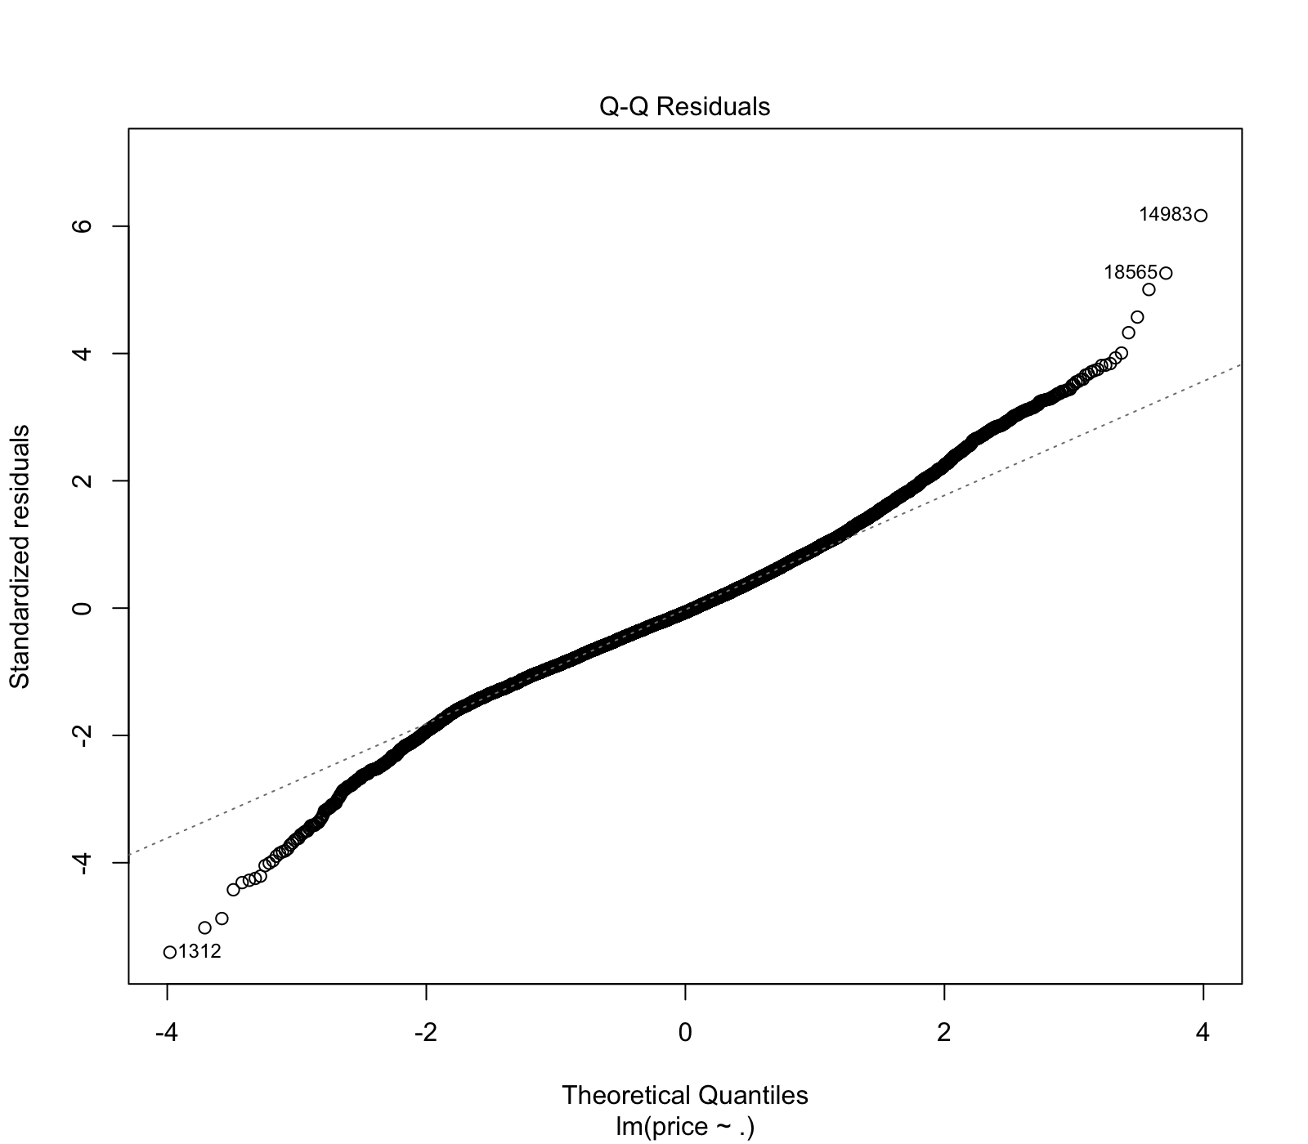
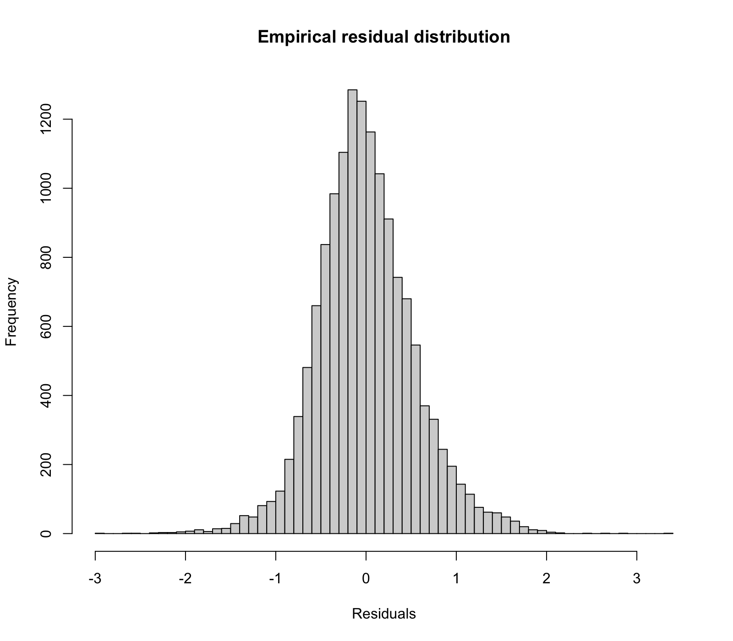
Residuals Analysis
Most of the residuals are in the [-1;1] range (which means from -1000$ to 1000$).
The model works better on the central prices values.
Shapiro test confirms that residuals are not normally distributed.

Slide 14
Interaction term between dimensions
How could the model be influenced by physical variables if considered together?
Better results considering the interaction between variables?
Length
Width
Depth

Slide 15
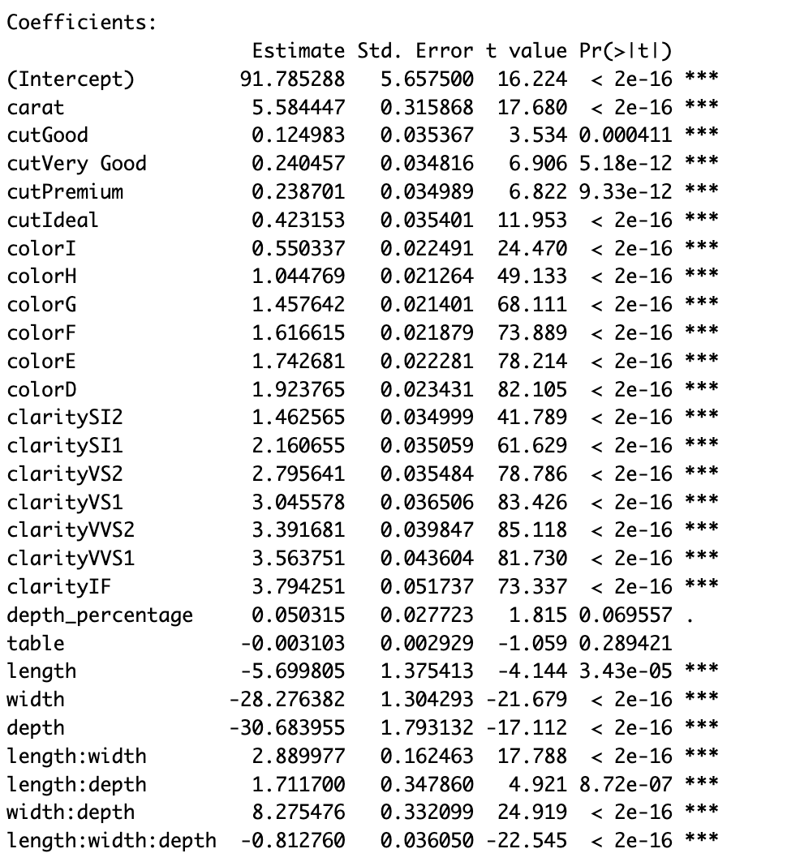
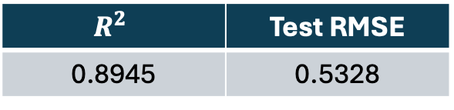
Linear regression
Both 2nd order interaction and 3rd order interaction are significativity.
The new model is better then the previous one (smaller RMSE).
$$R^{2}$$ | Test RMSE
0.8945 | 0.5328

Slide 16
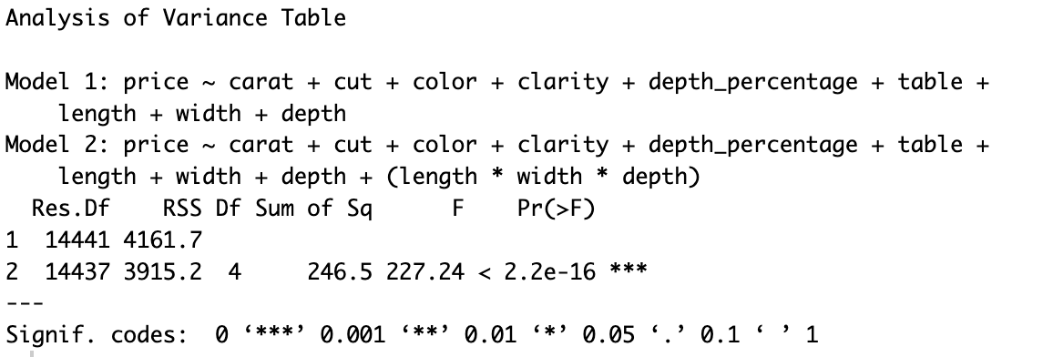
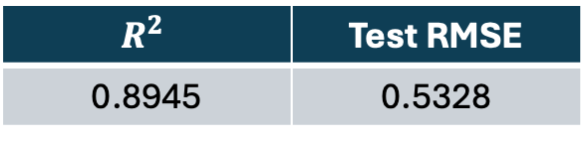
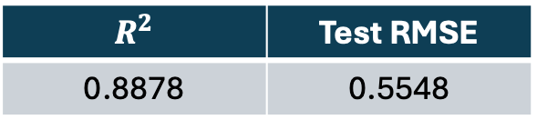
Comparison between models
Anova Test
First Model:
$$R^{2}$$ | Test RMSE
0.8878 | 0.5548
Second Model:
The anova test shows that the second model is better compared to the first one.
$$R^{2}$$ | Test RMSE
0.8945 | 0.5328

Slide 17
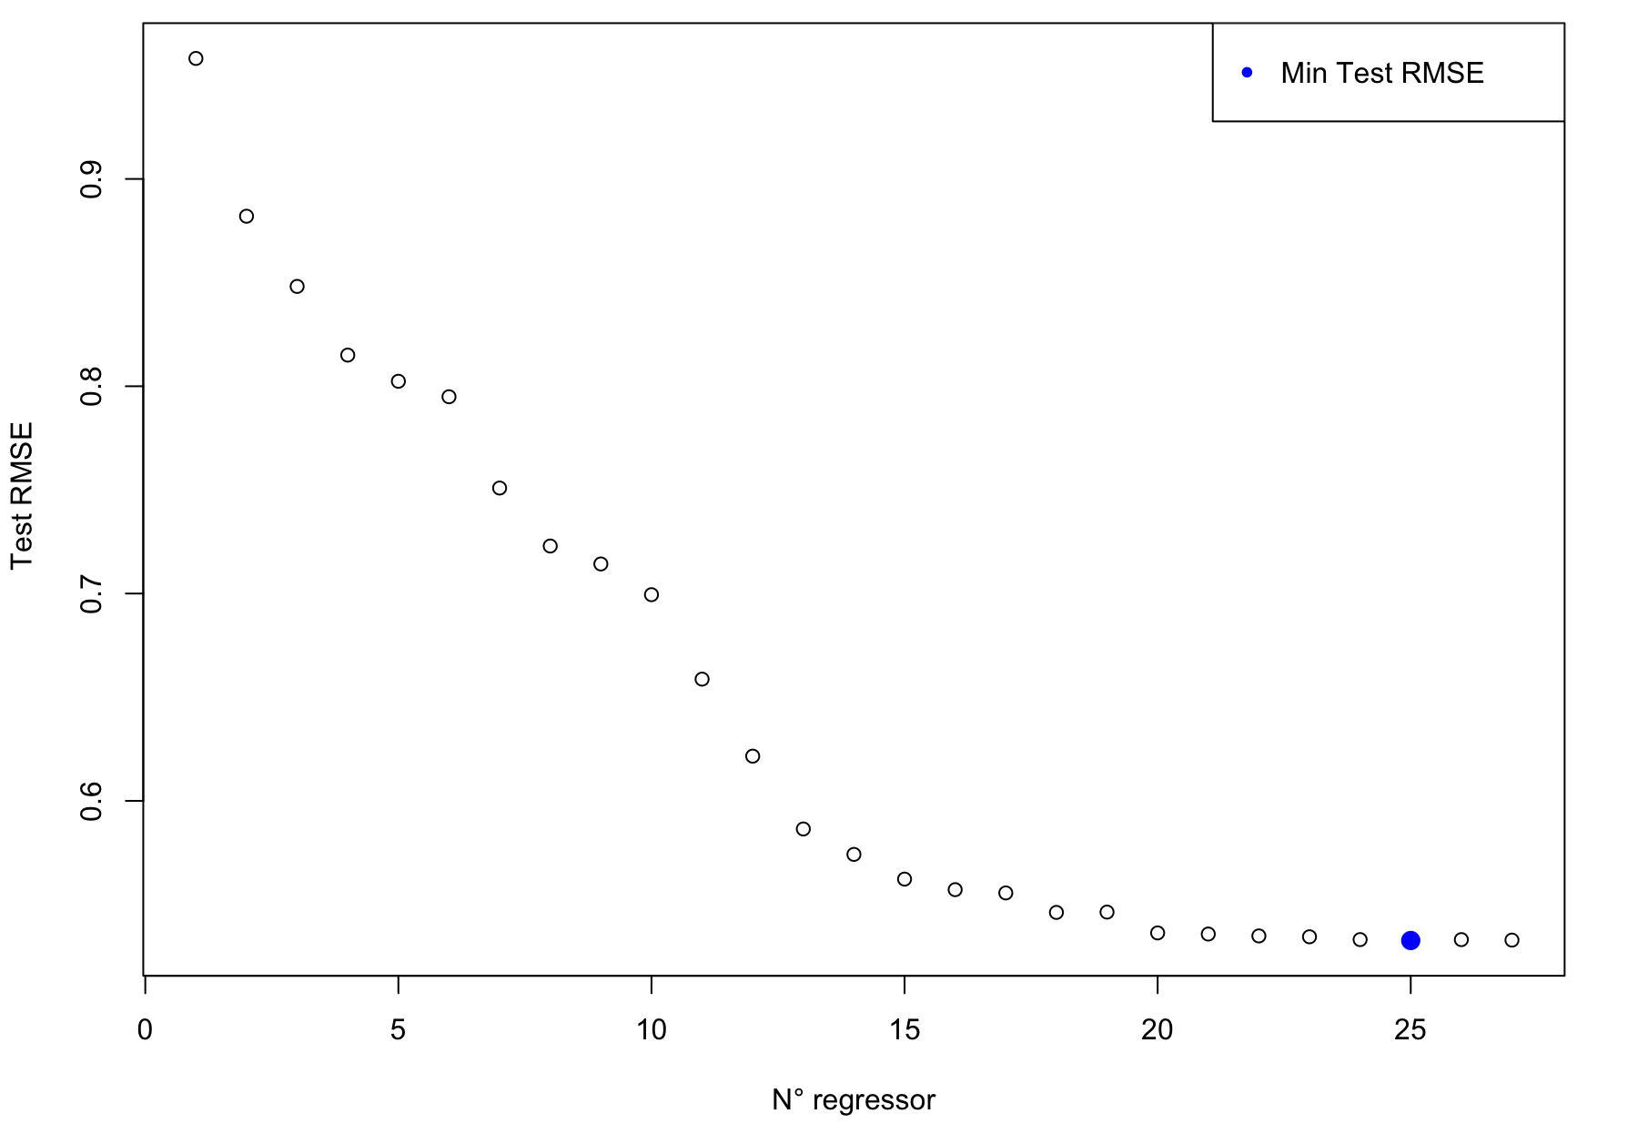
Best subset selection
Best subset selection with regsubset() command.
For each model (from 1 to 27 regressors) we calculated the RMSE test.
The best model has 25 regressors.
The deleted regressors are table and depth%.
This is the best achieved RMSE.
Test RMSE
0.5326

Slide 18
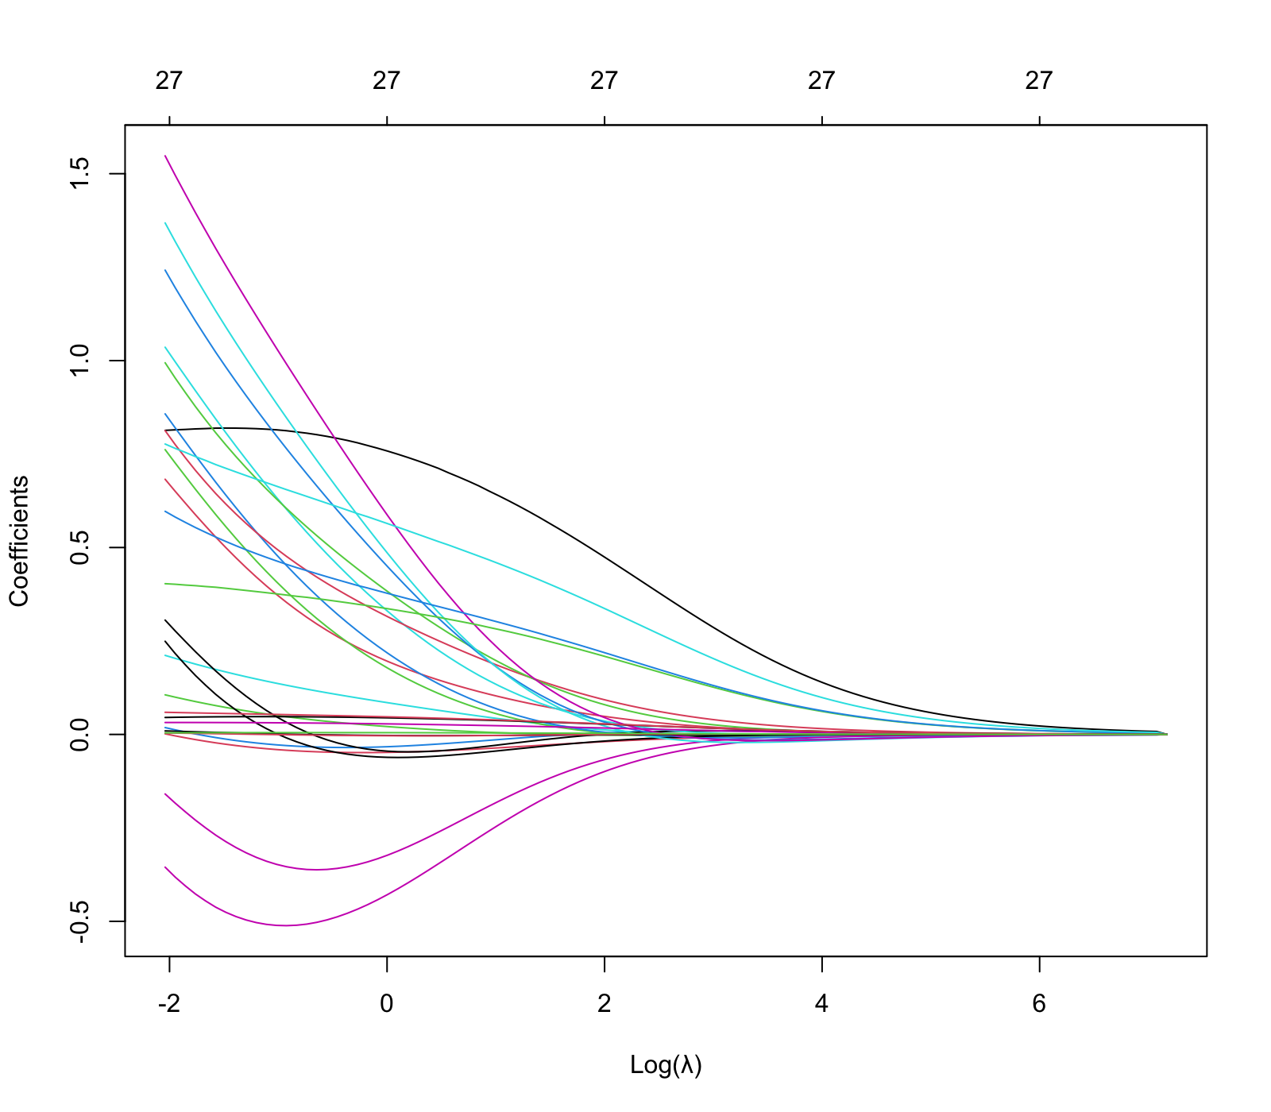
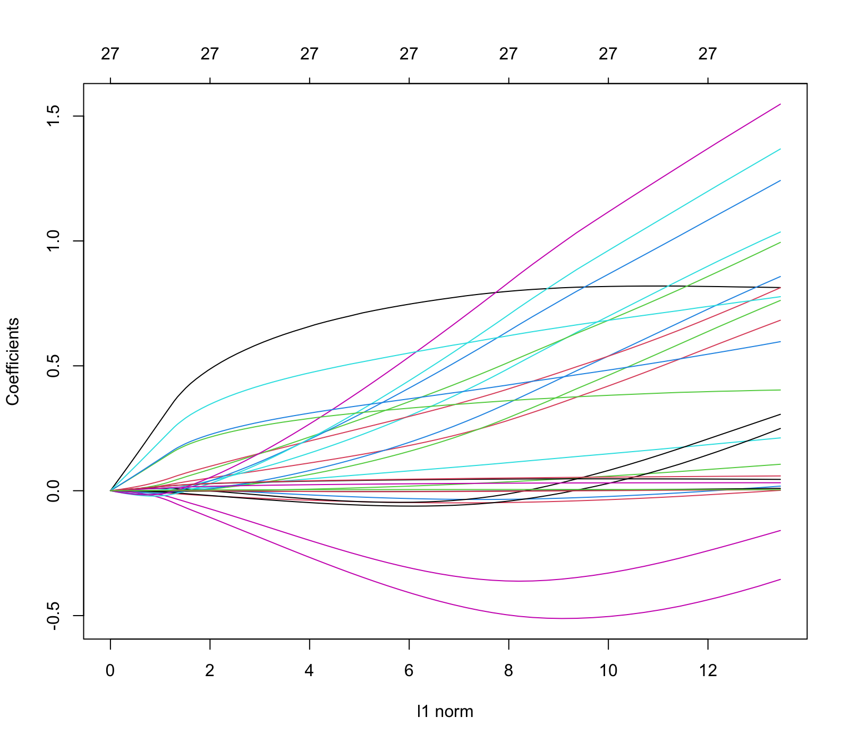
Ridge regressions

Slide 19
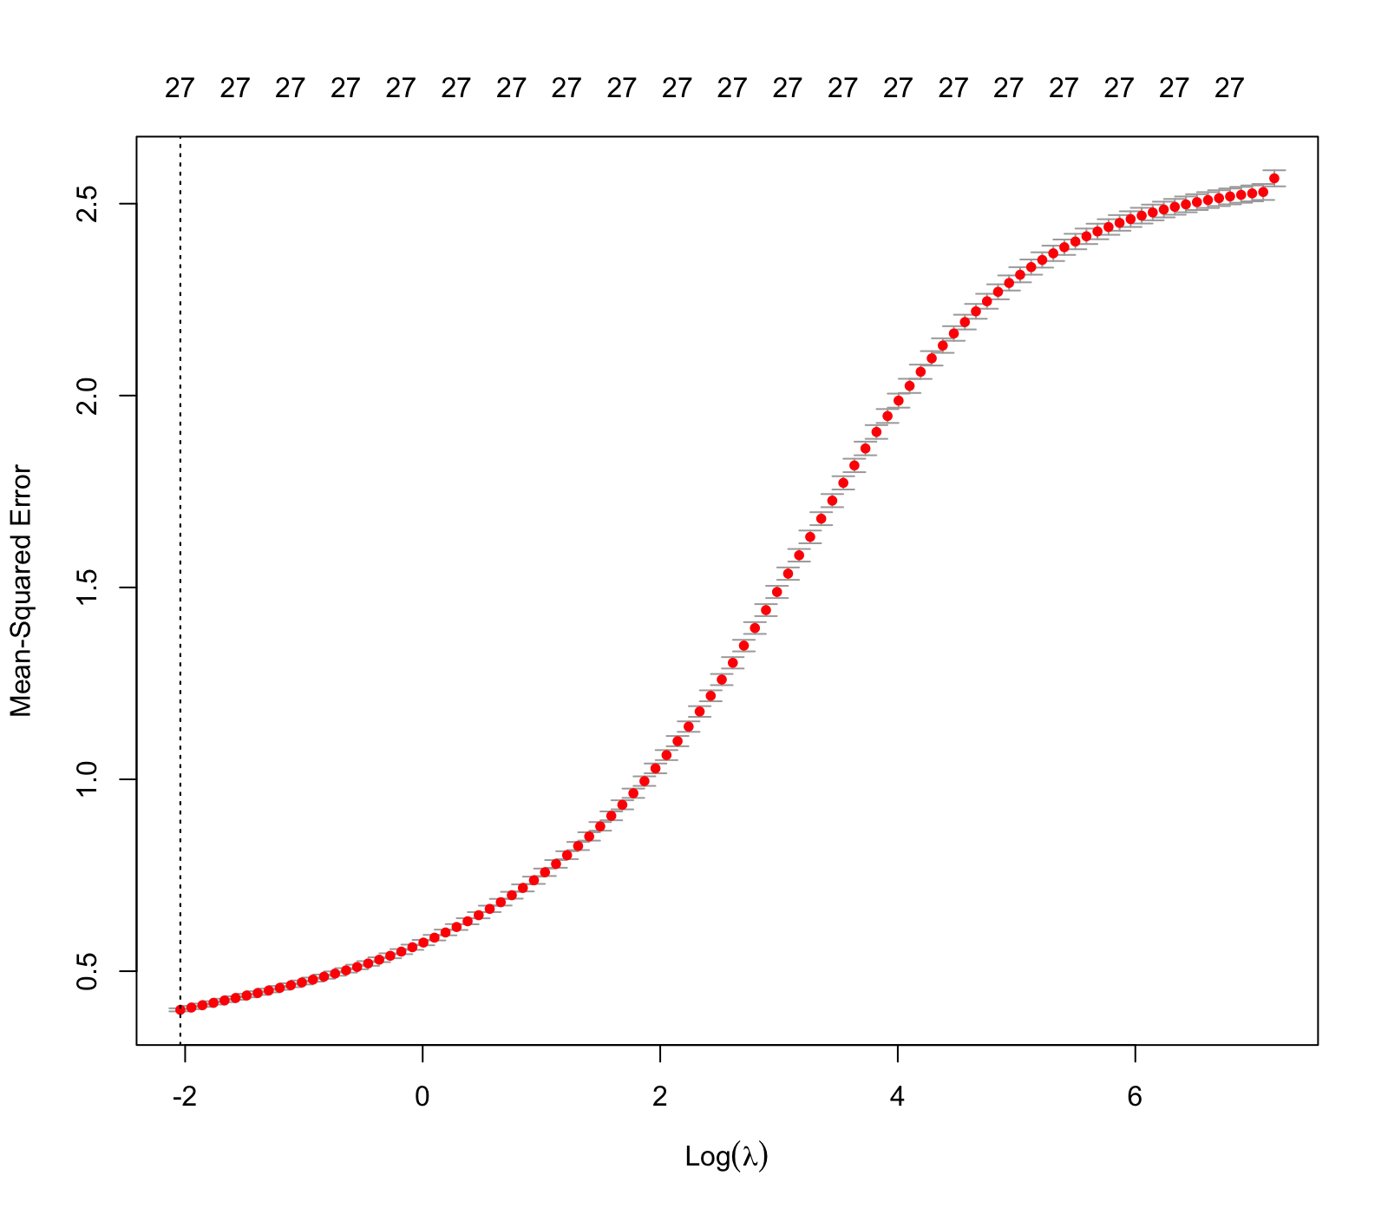
Ridge regressions
Ridge regression model perform worst then the linear regression model.
The reduction of the variance doesn’t worth the increasing of the bias.
Test RMSE | Best Lambda
0.6561 | 0.1297

Slide 20
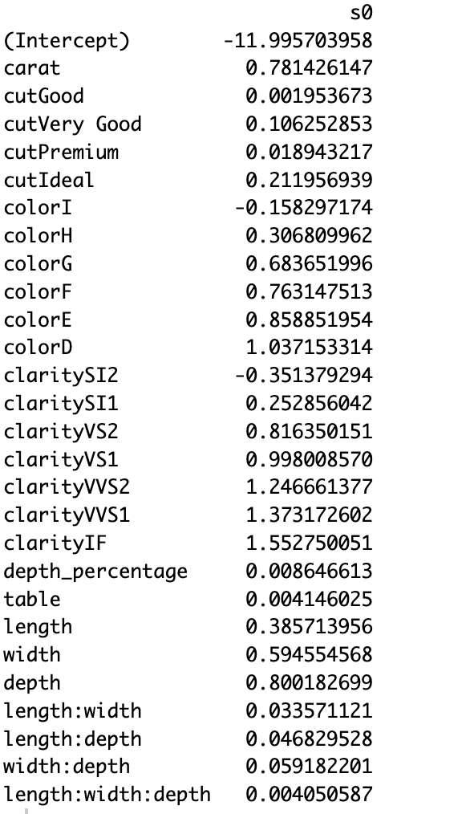
Ridge regressions
With ridge regression coefficients has values closer to zero.

Slide 21
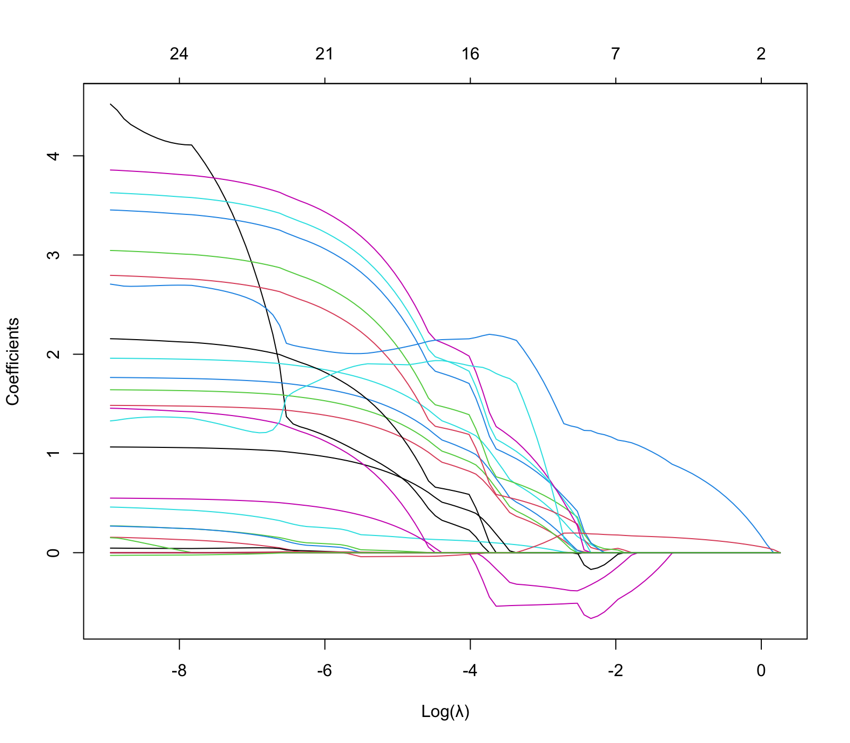
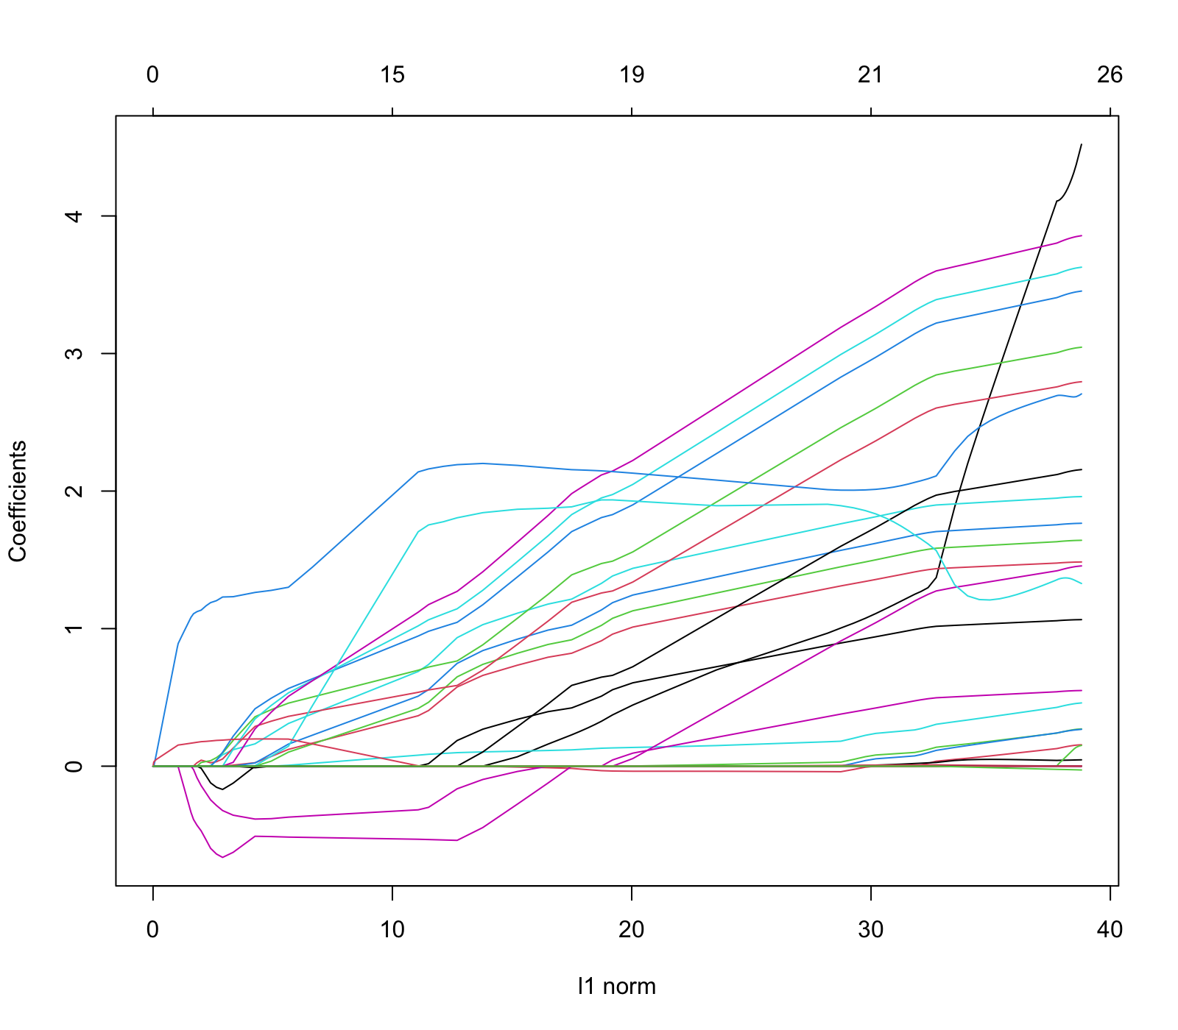
lasso regressions

Slide 22
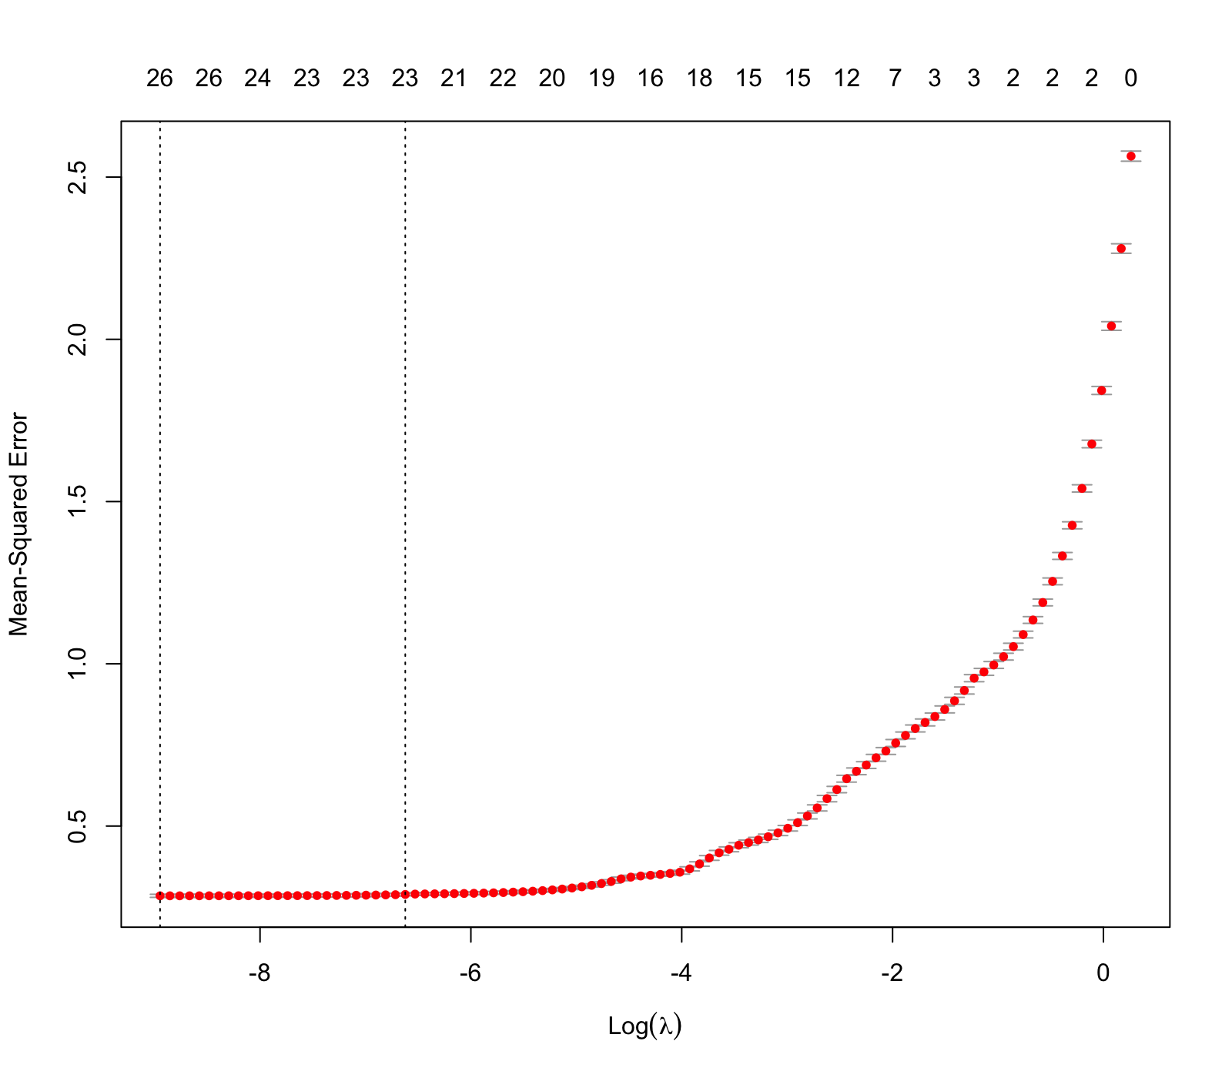
lasso regressions
The lasso regression model performed better with lower values of lambda.
Test RMSE | Best Lambda
0.5466 | 0.0001

Slide 23
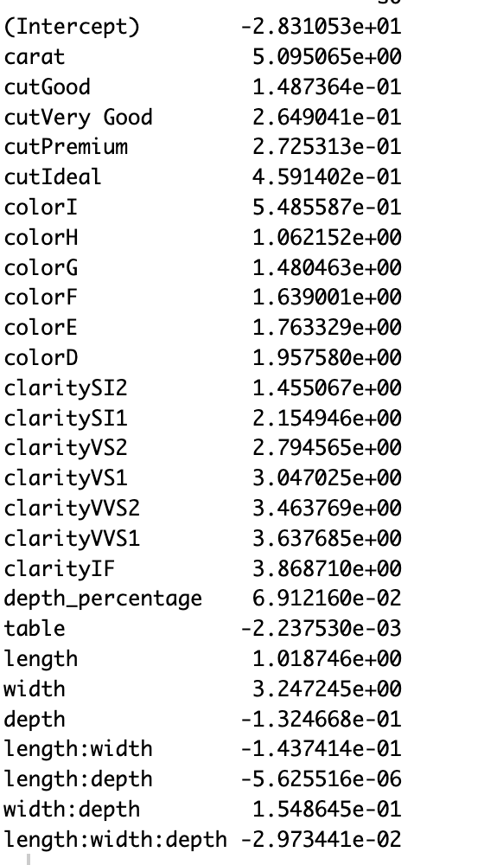
lasso regressions
The value of lambda chosen by the model doesn’t brings coefficients to zero.

Slide 24
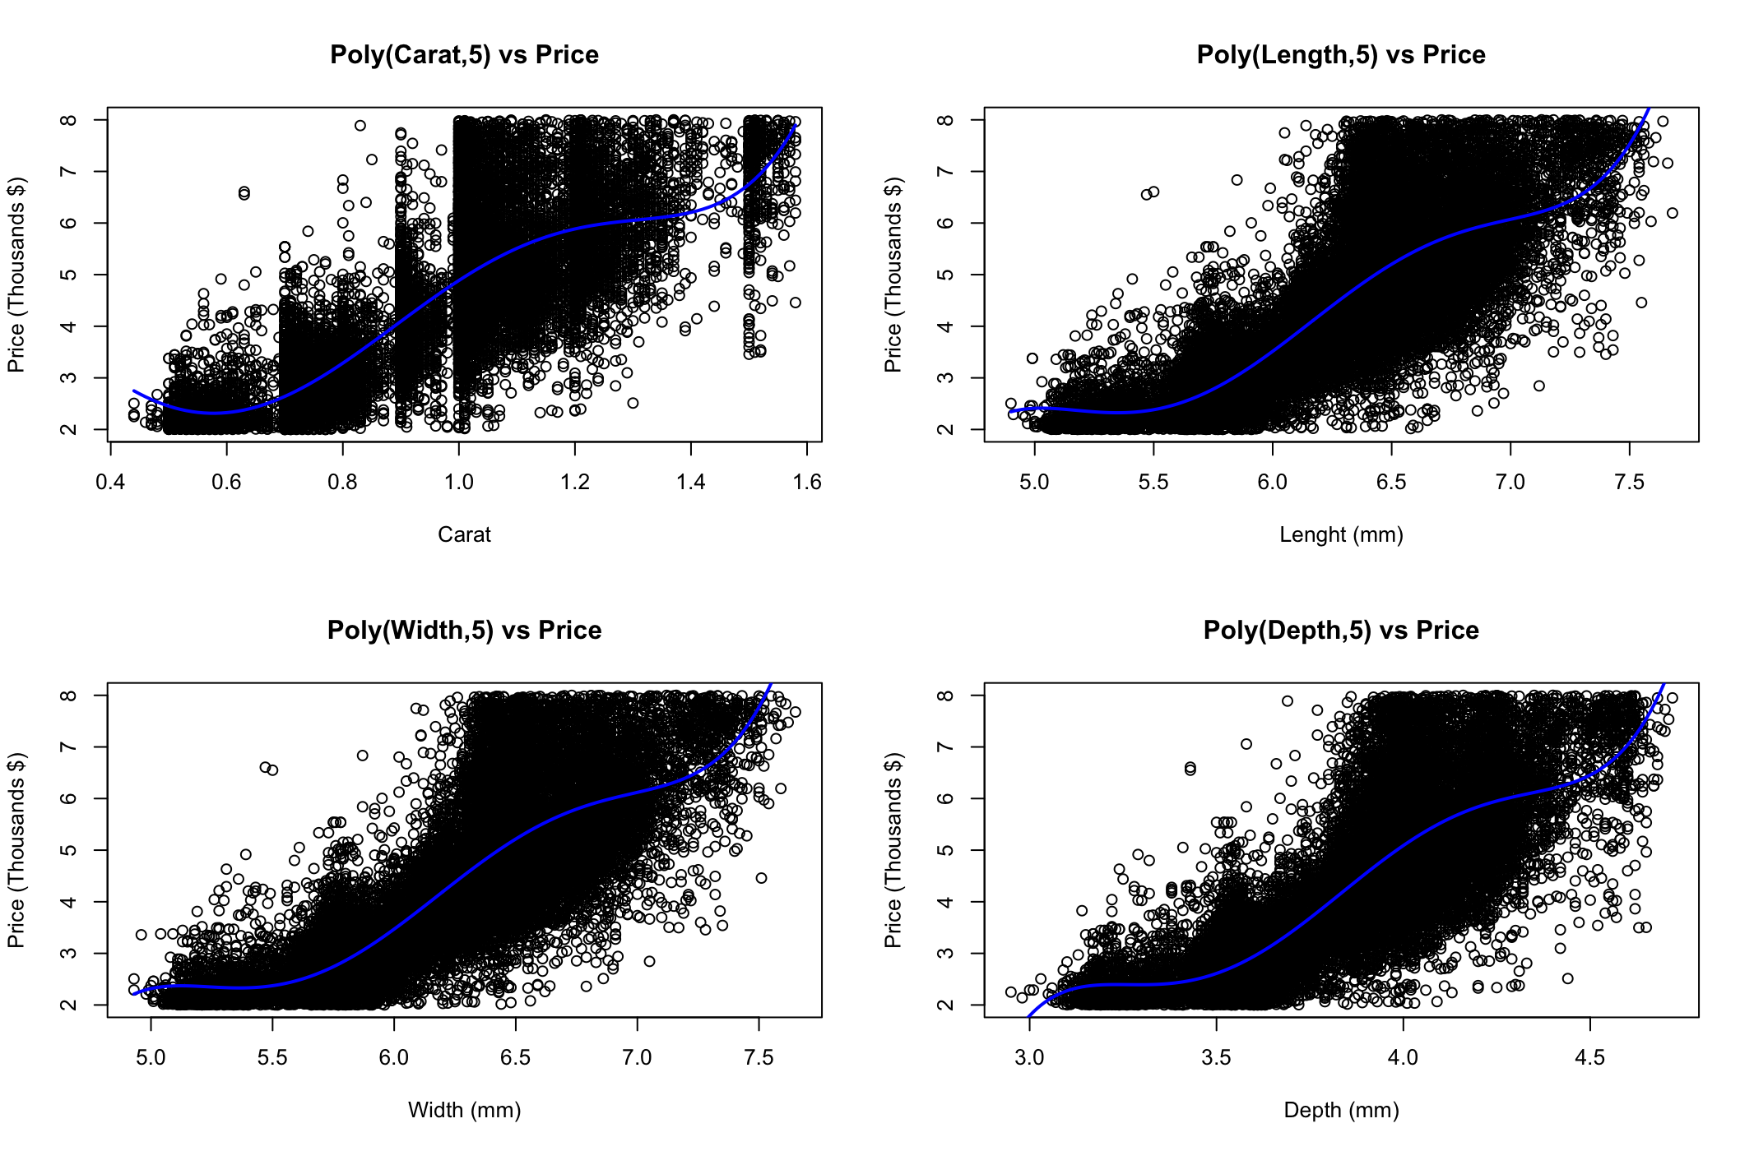
Polynomial Regression
To perform a multiple polynomial regression, searching best poly grade for each feature.
Comparison of polynomials from 1 to 5 and select the best by Anova test.
Plots variables vs response with chosen poly degree.

Slide 25
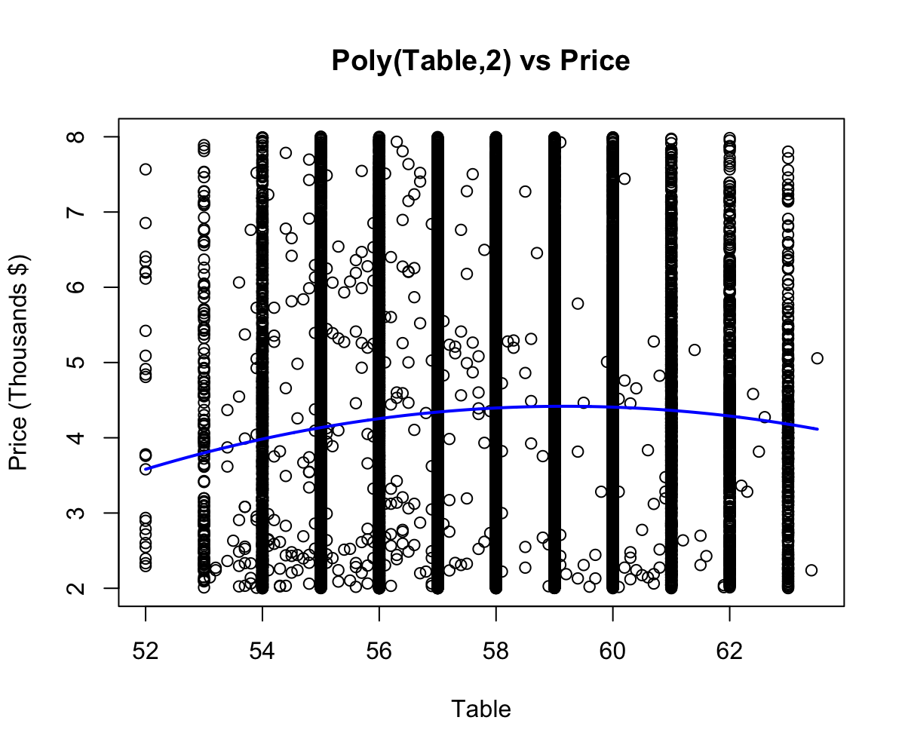
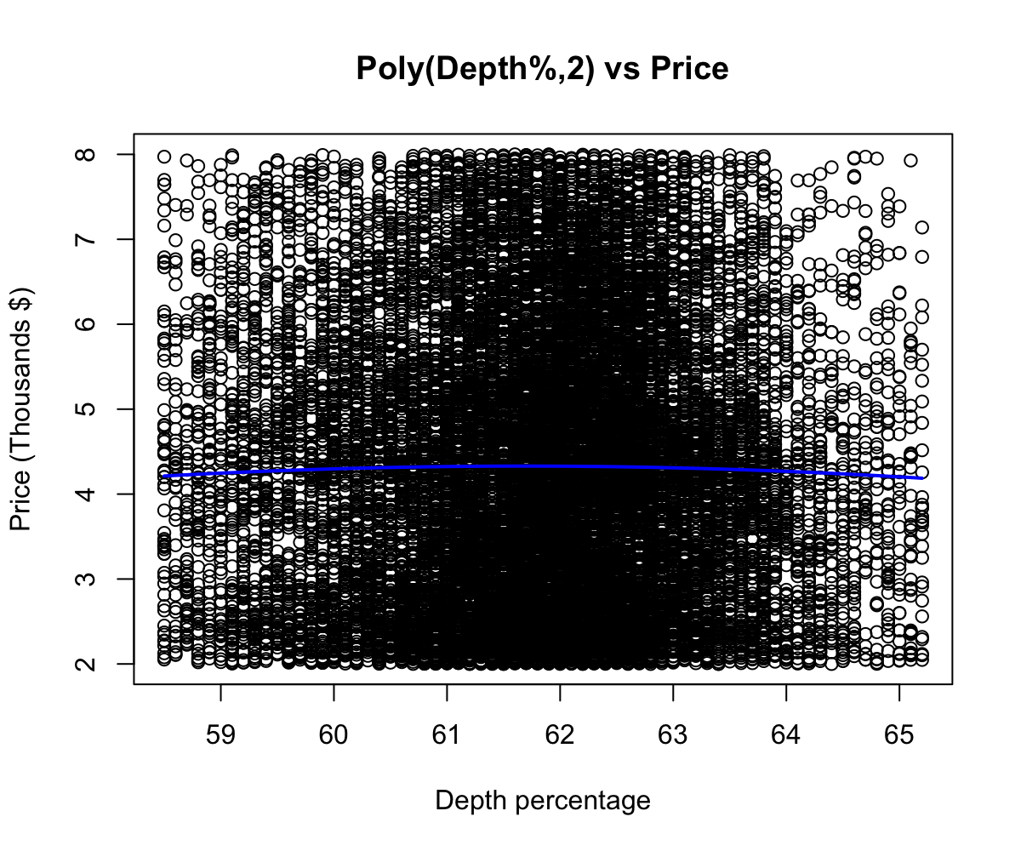
Polynomial Regression
The test RMSE is better compared to the linear models.
To fit multiple polynomial regression, the chosen orders are:
Carat, Length and Width ~ ord(5)
Table and Depth% ~ ord(2)
Test RMSE
0.5216

Slide 26
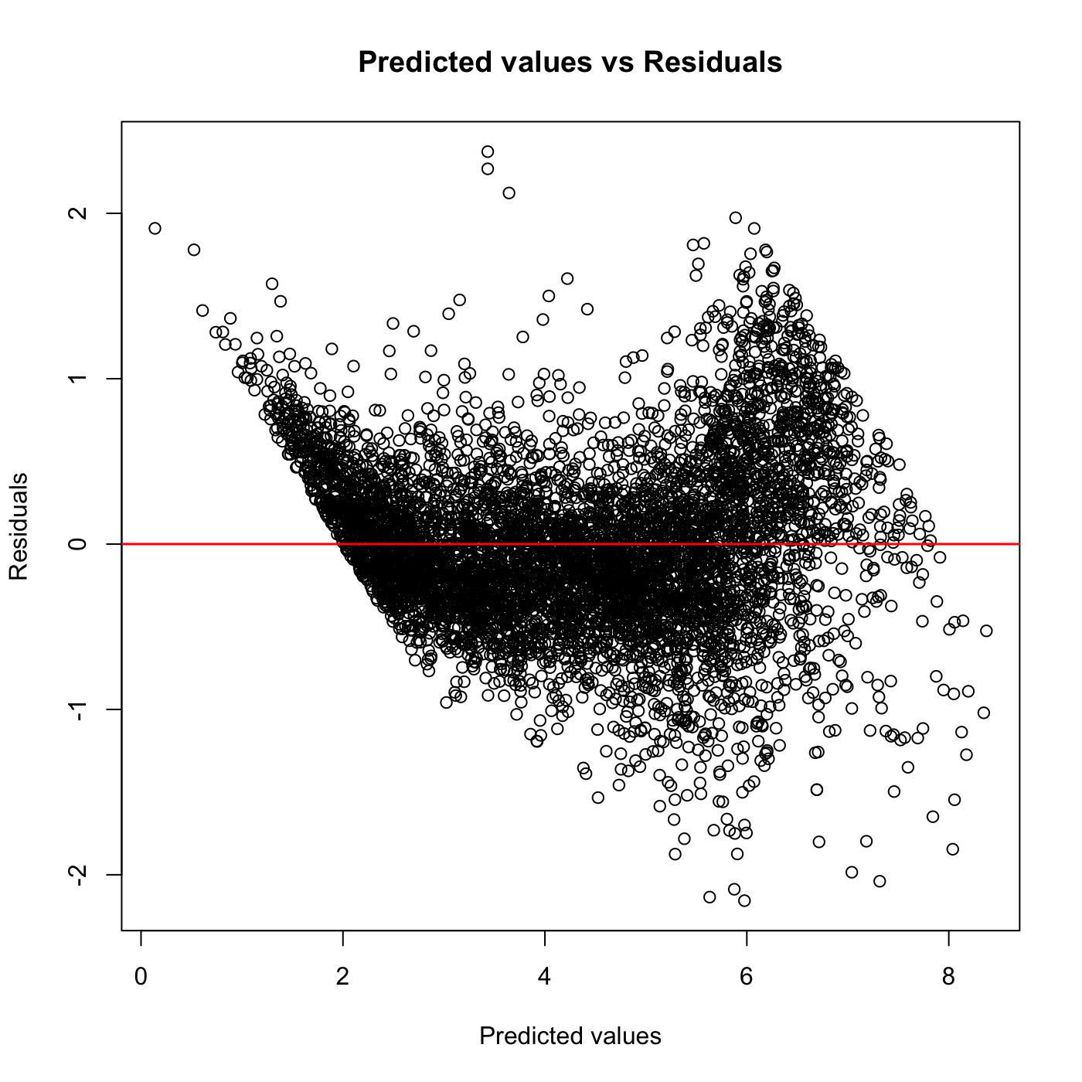
Generalized Additive Models
GAM model with smooth spline.
Test RMSE better then the one obtained with polynomial and linear regression.
Test RMSE
0.5151

Slide 27
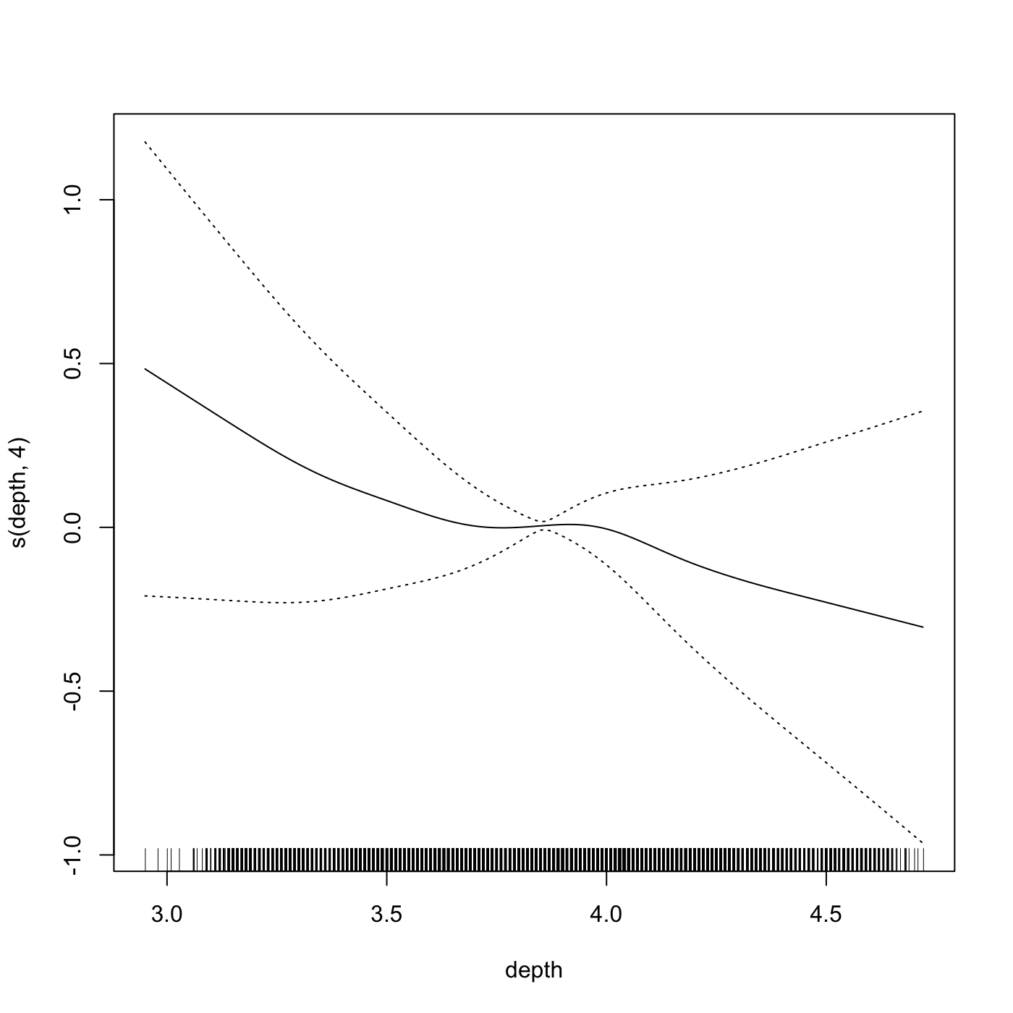
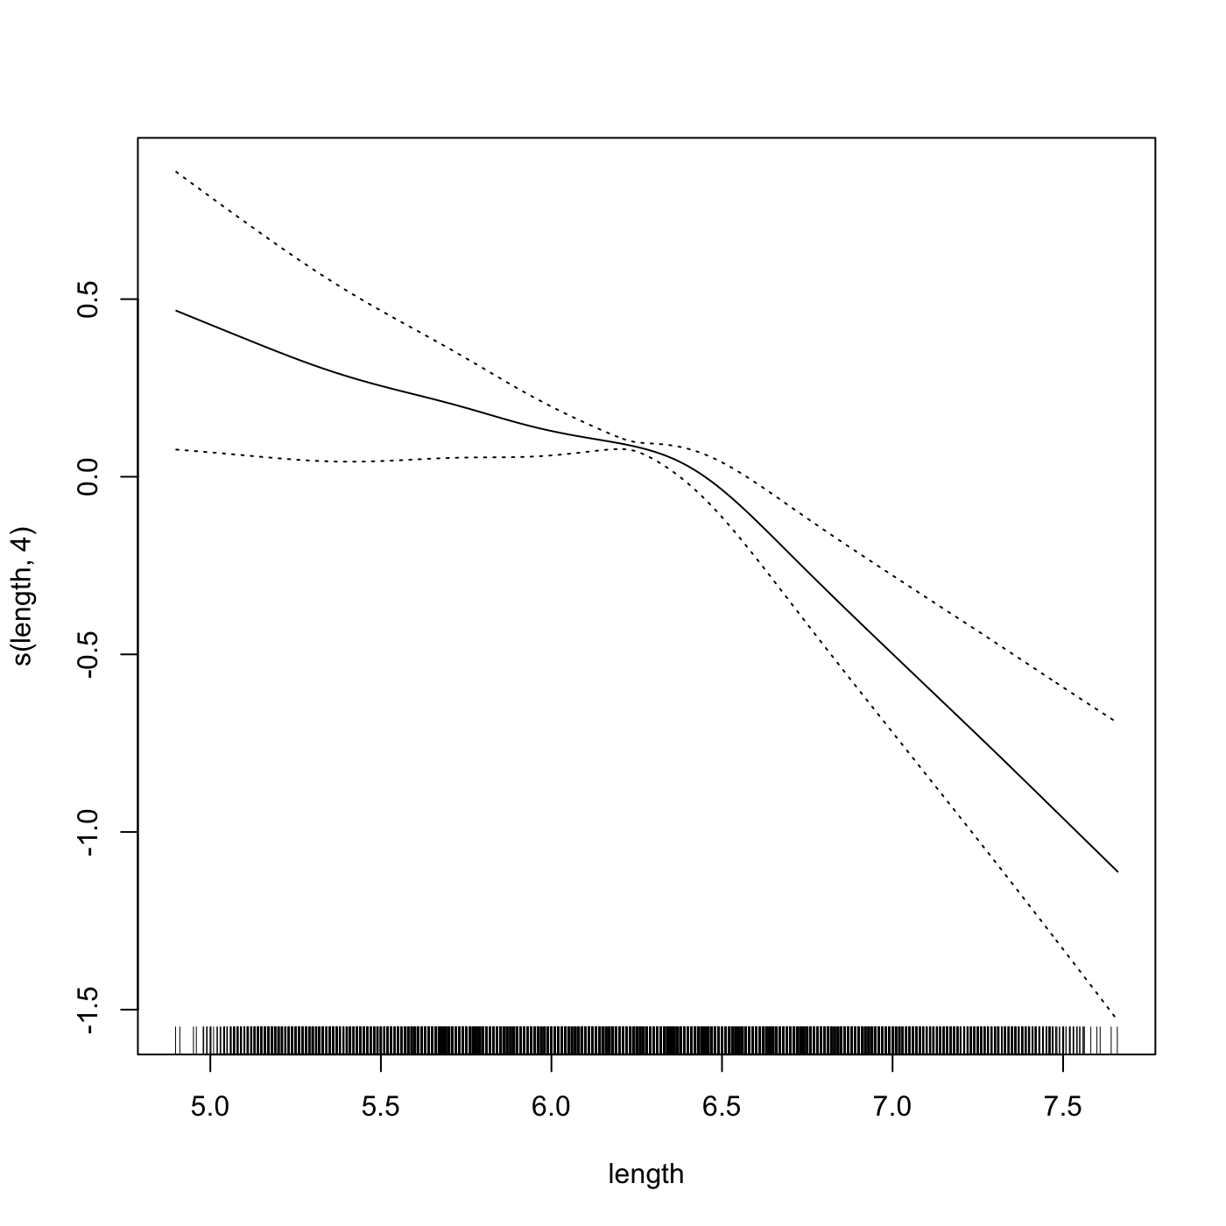
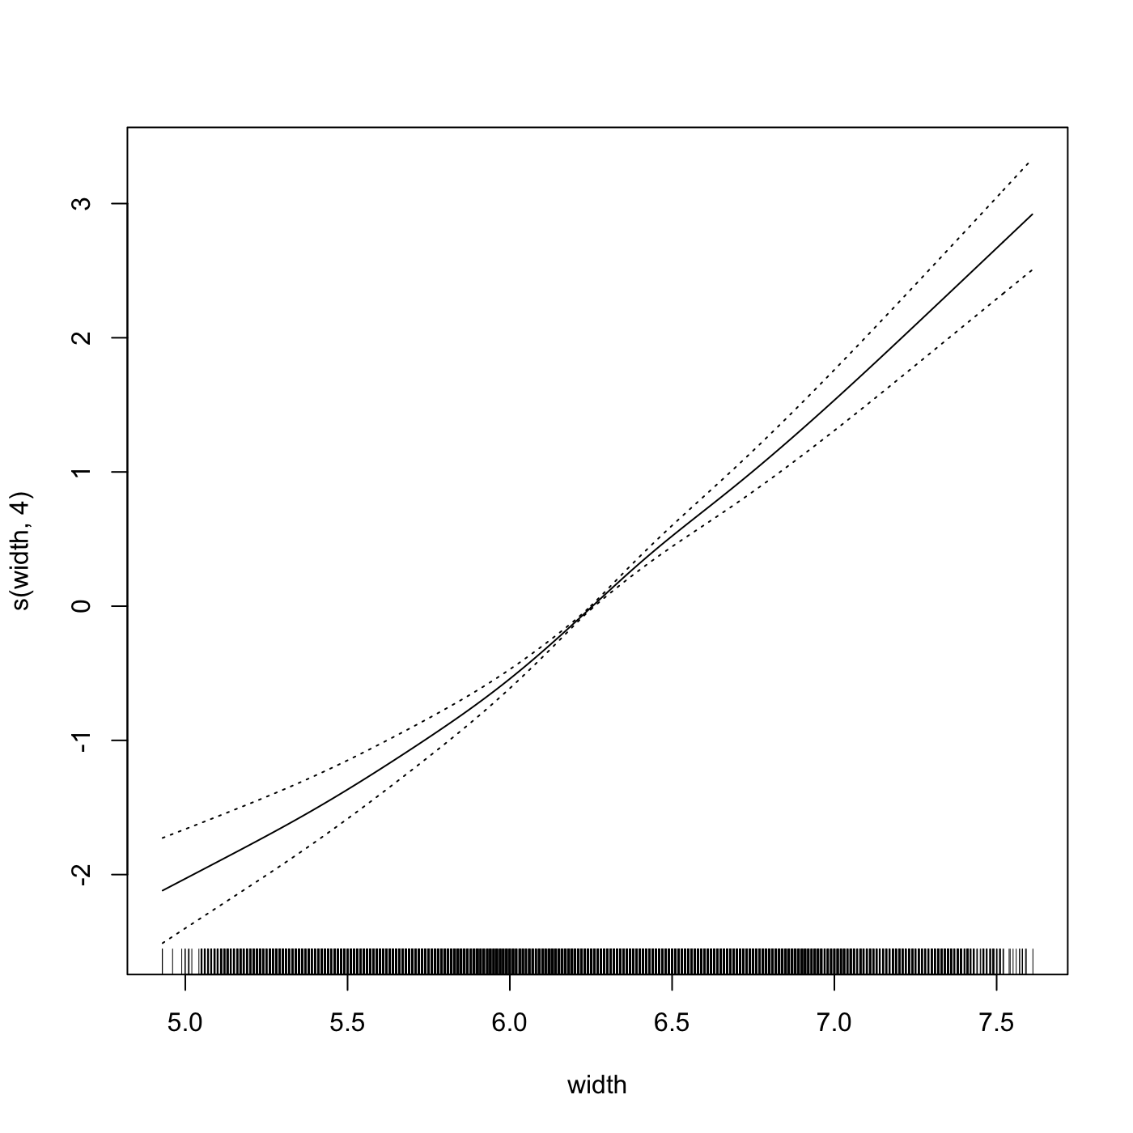
Generalized Additive Models

Slide 28
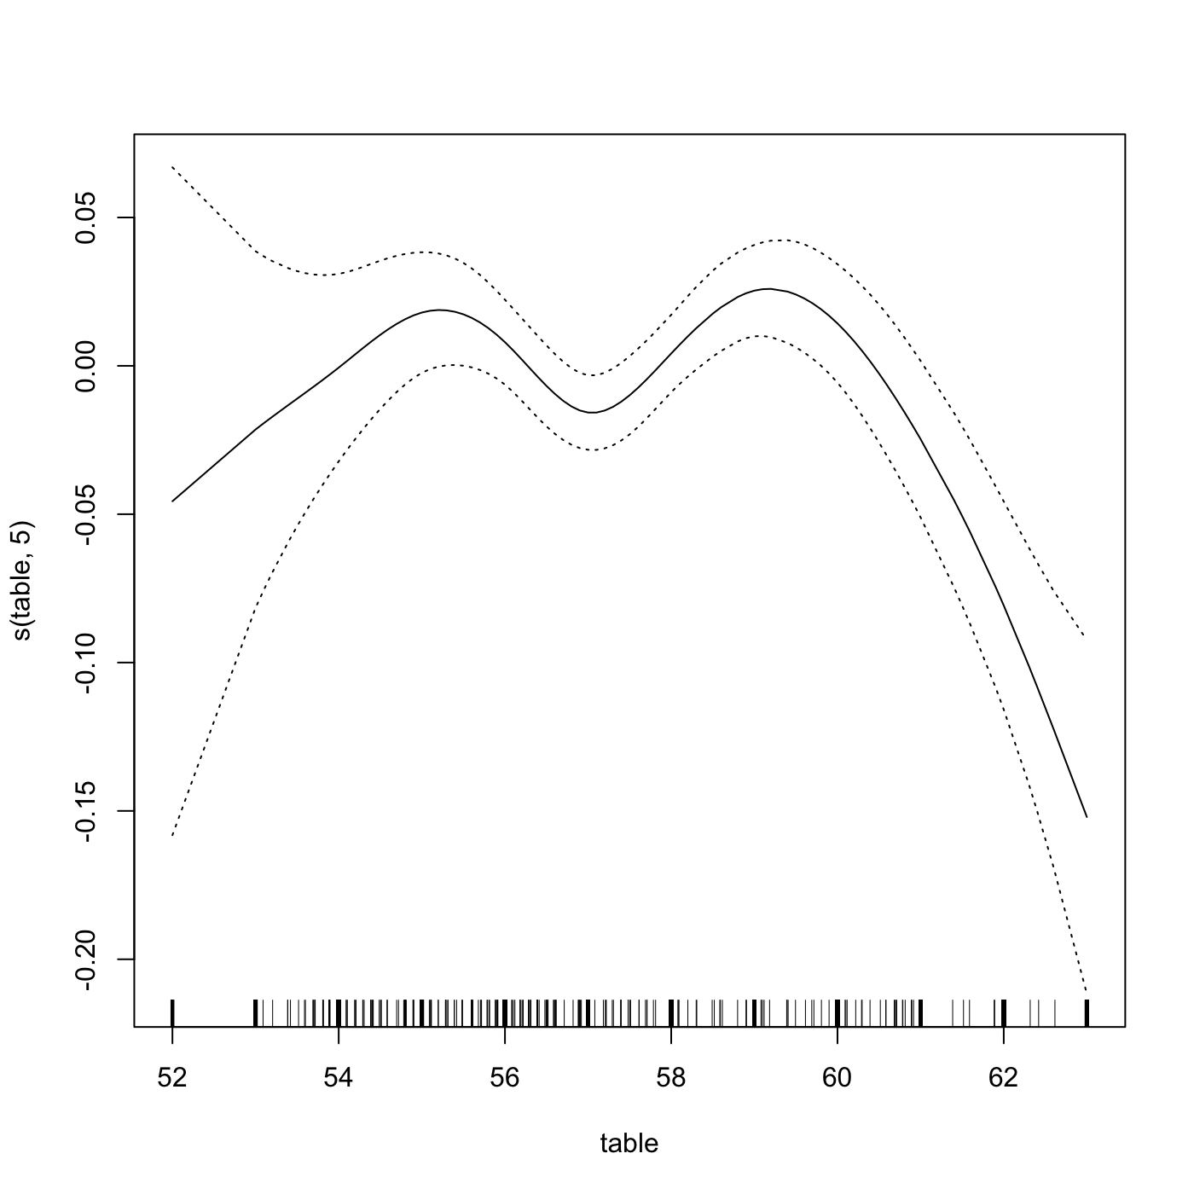
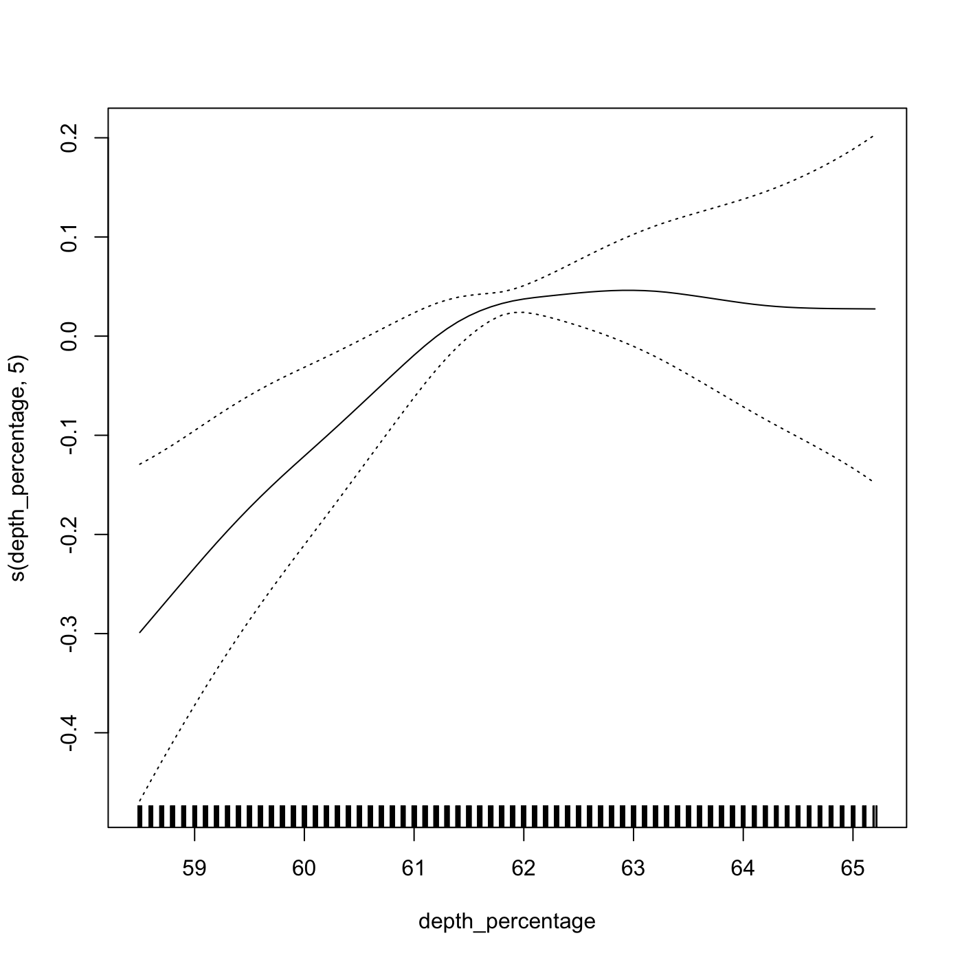
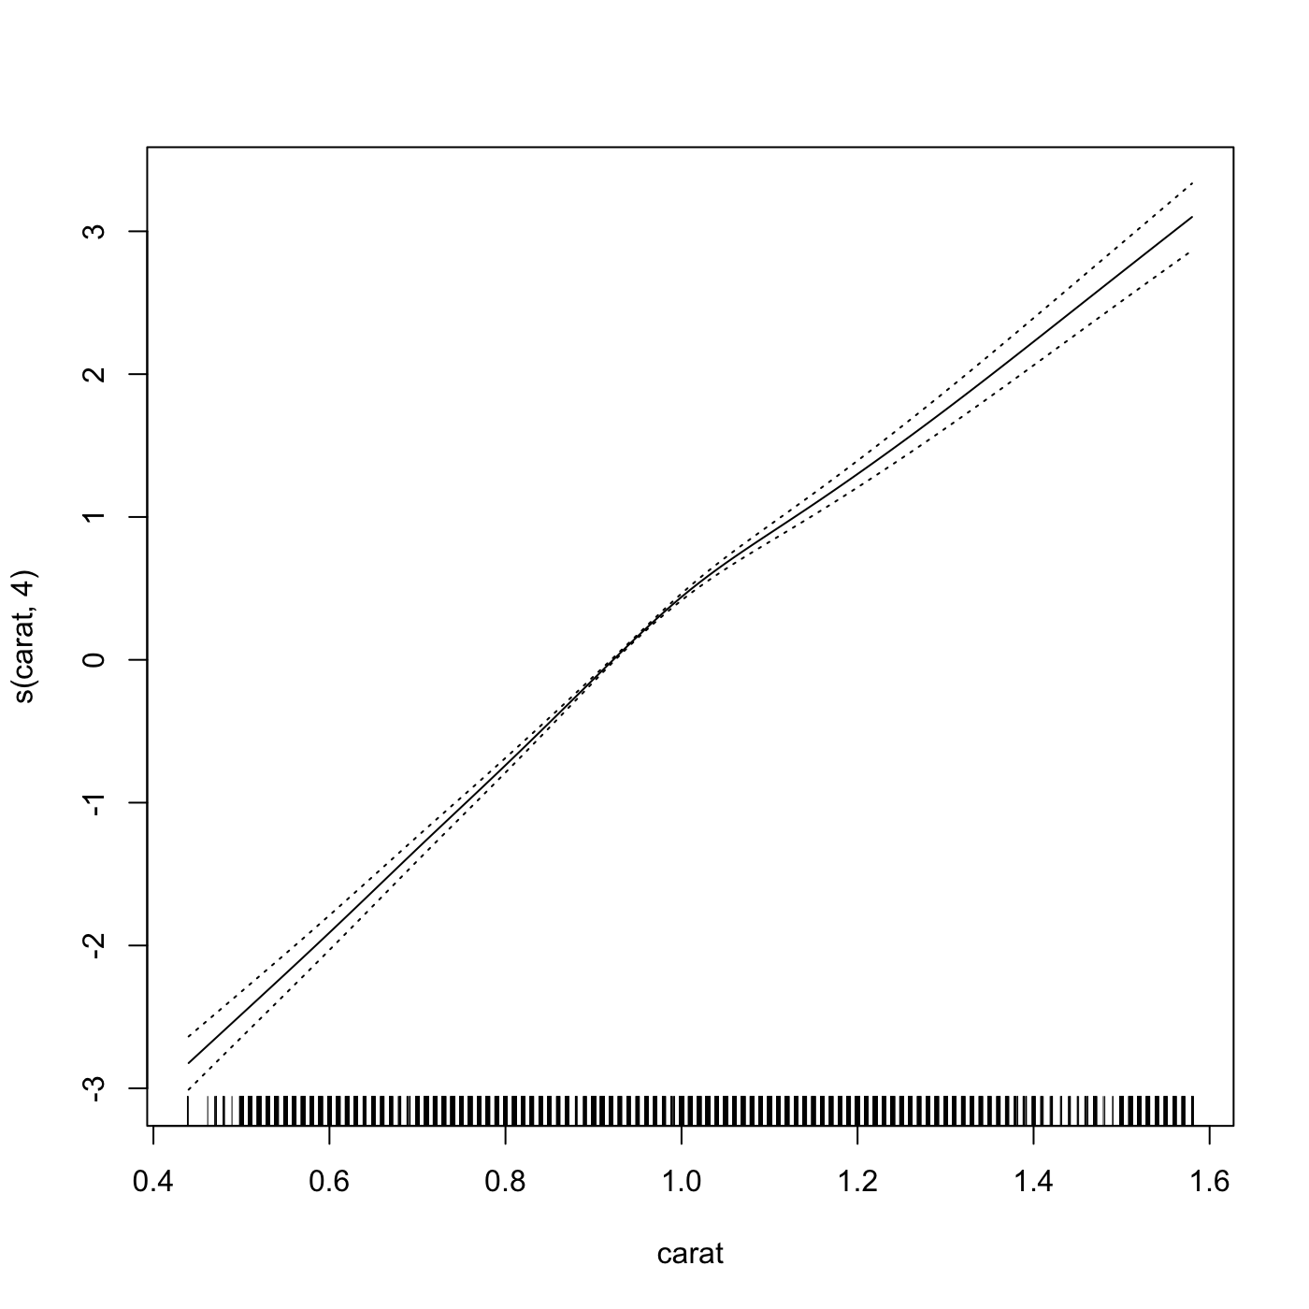
Generalized Additive Models

Slide 29
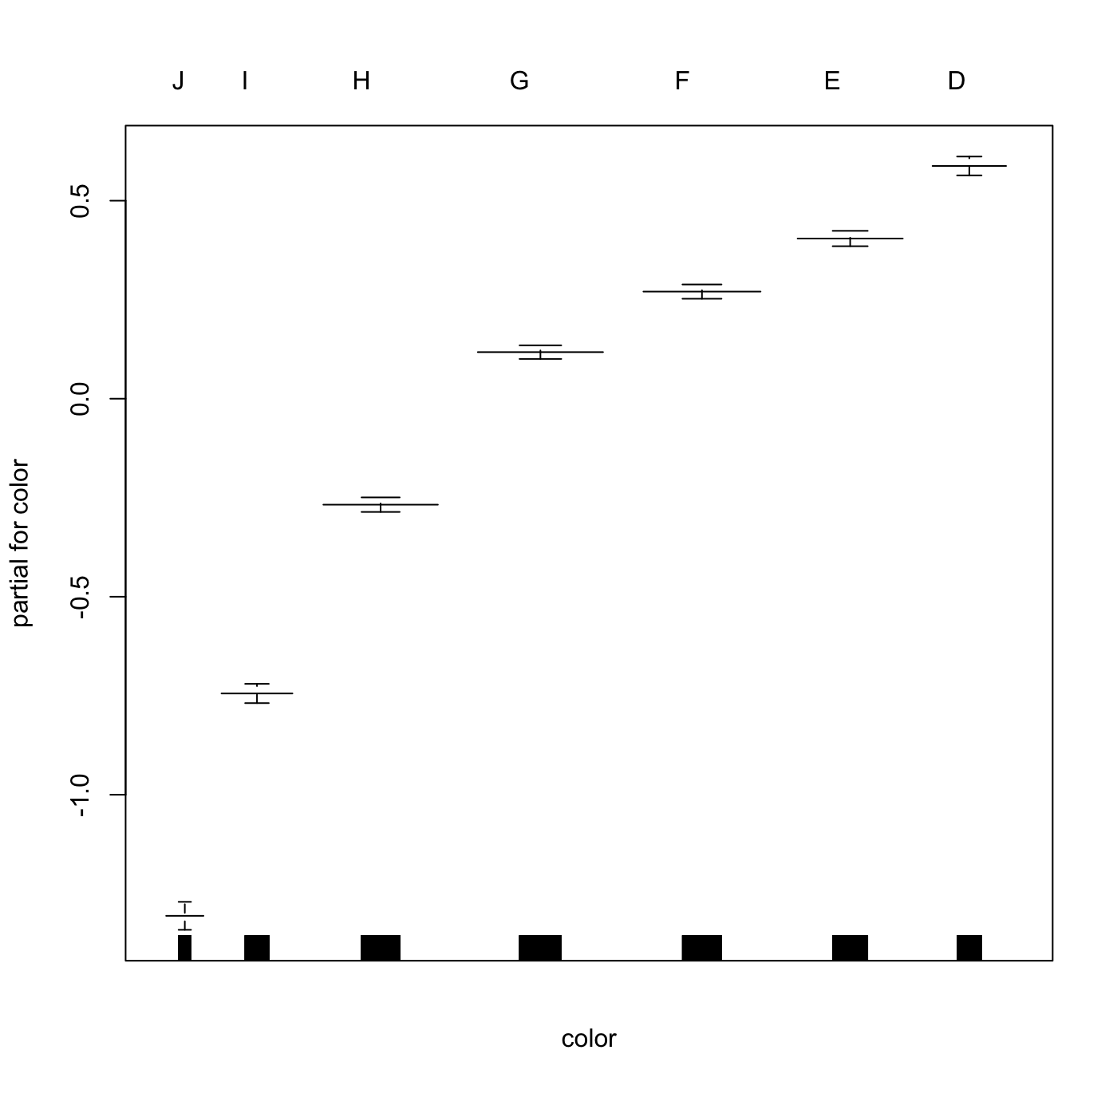
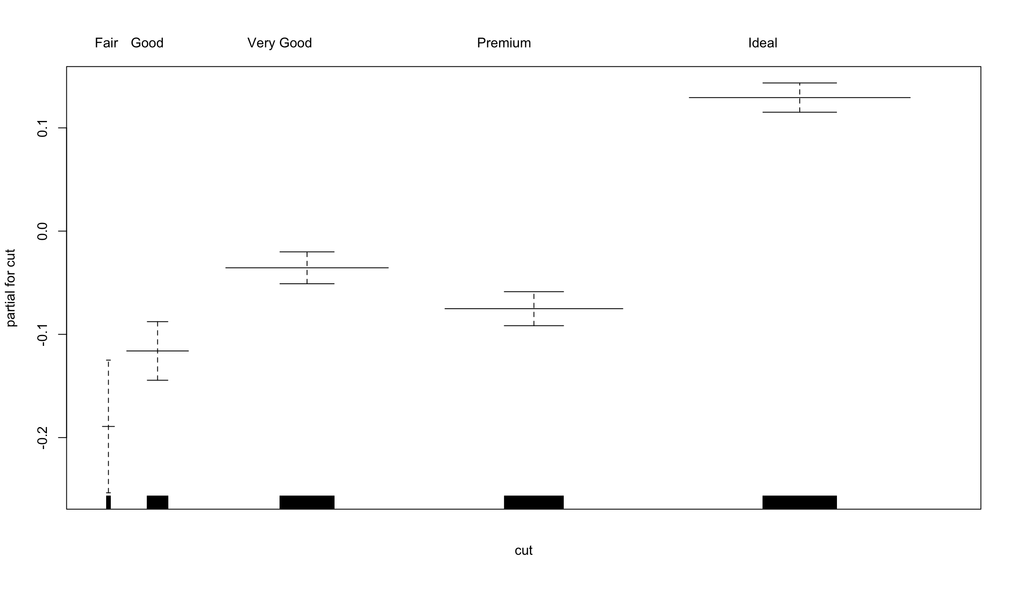
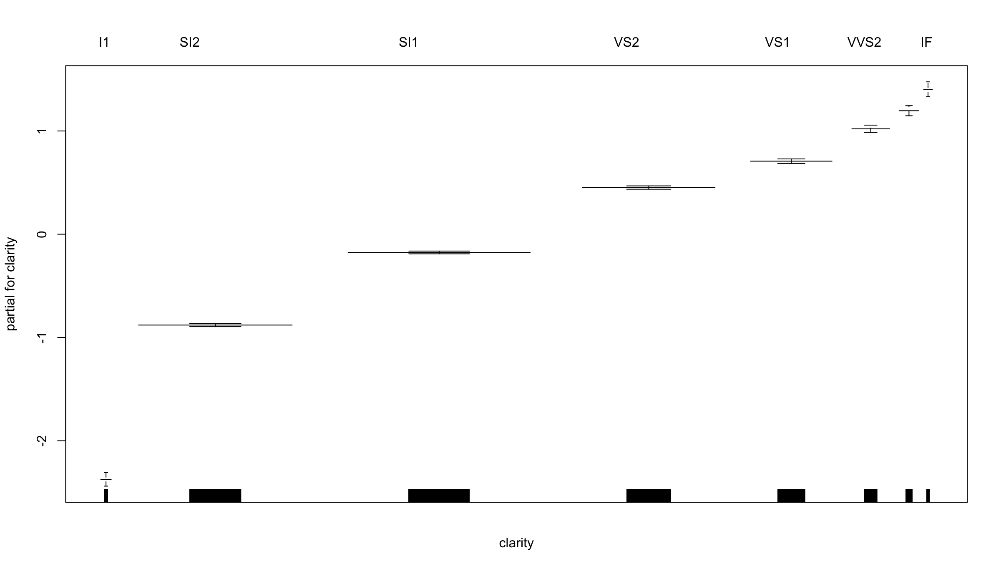
Generalized Additive Models

Slide 30
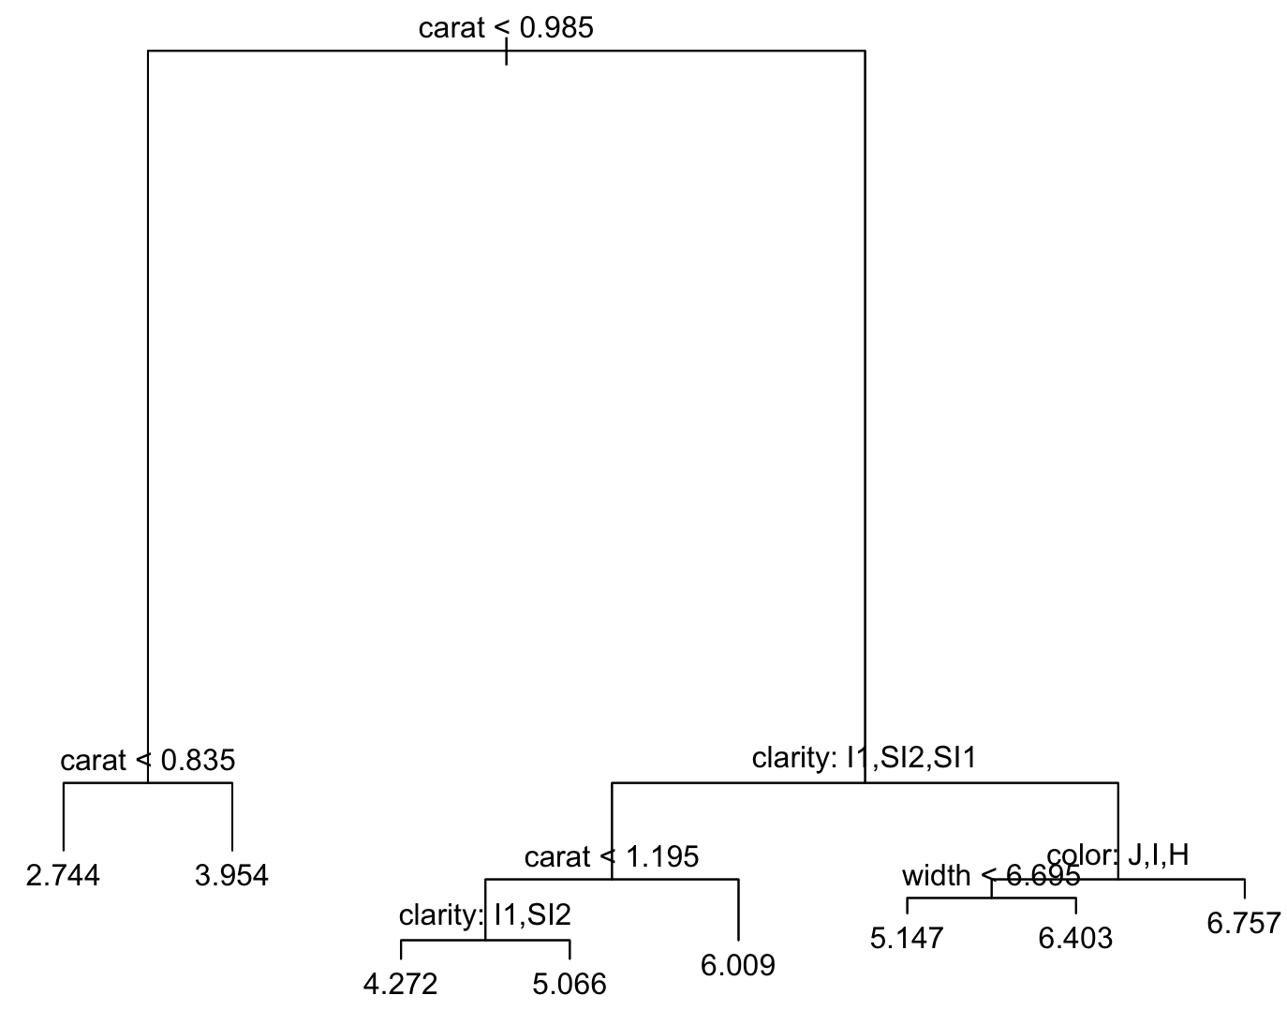
Regression trees
Regression tree.
Tried with pruning (crossvalidation pruning) but didn’t changed anything cause we already had the best number of leaves.
Test RMSE
0.7177

Slide 31
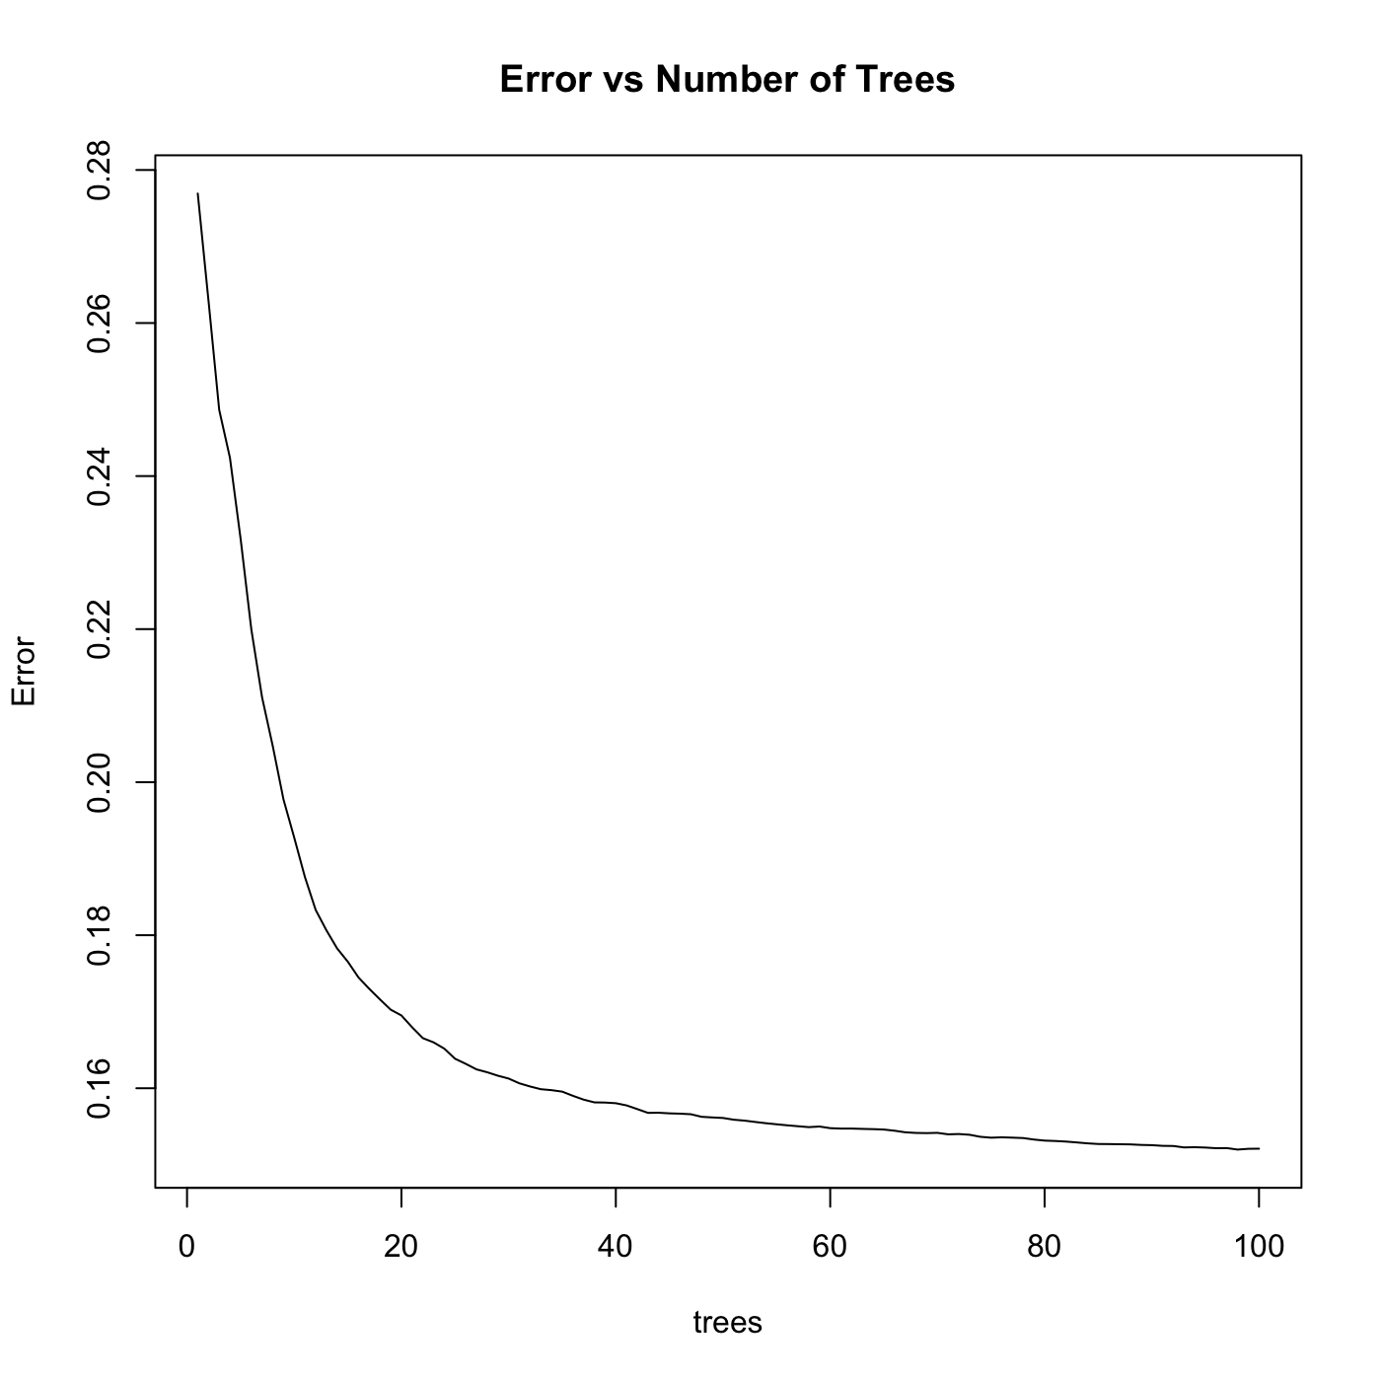
Bagging
Performed bagging with 100 trees.
The test RMSE is significantly better compared to the other models.
Test RMSE
0.4015

Slide 32
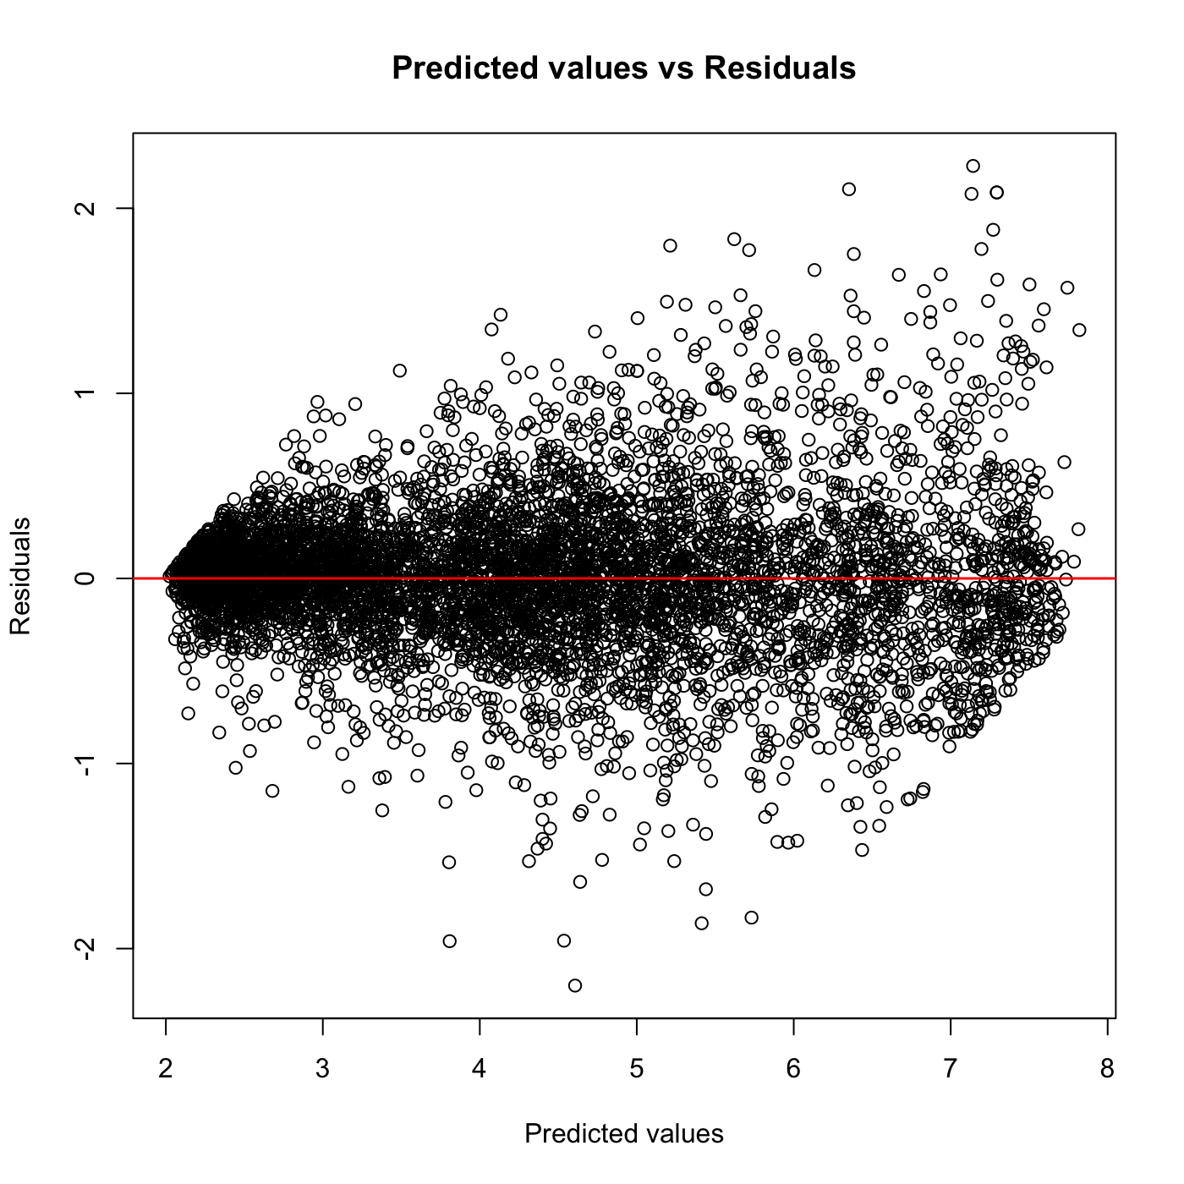
Bagging
The graph shows how more accurate are the predictions compared with the linear models.

Slide 33
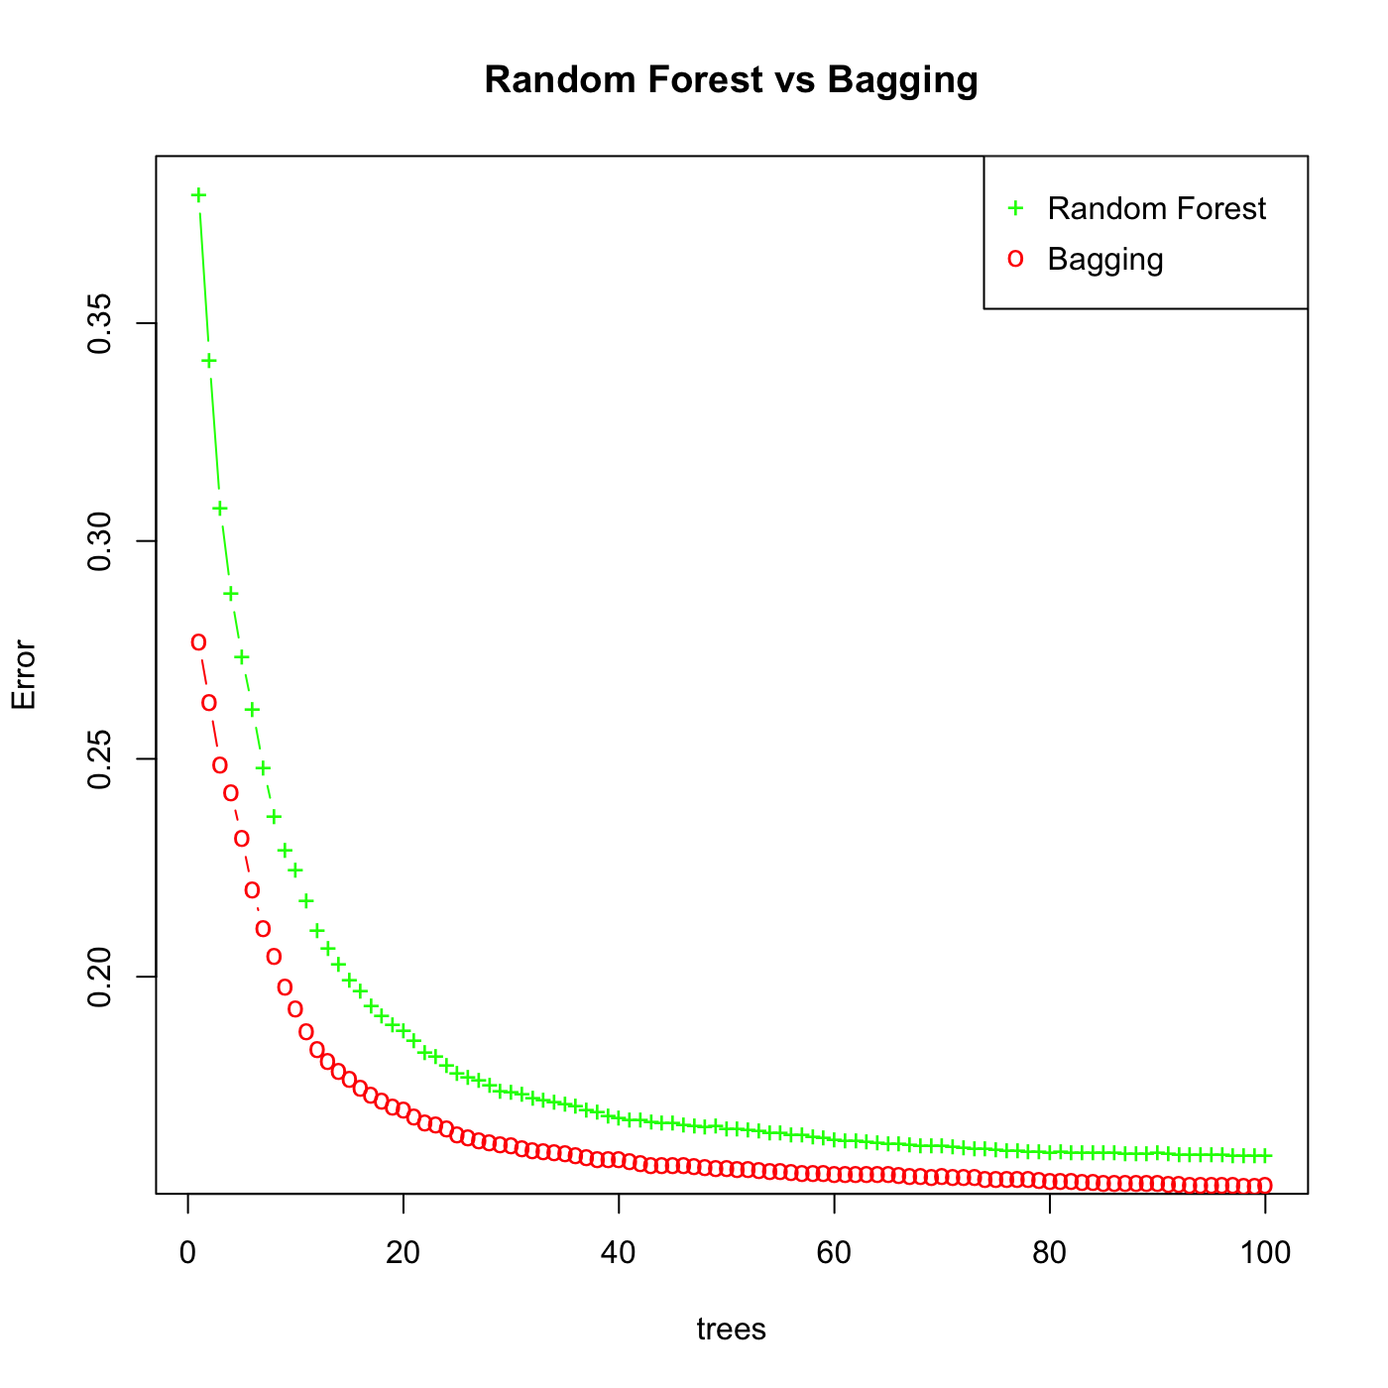
Bagging vs Random Forests
Random forest performed with m = sqrt(p)
Comparison between bagging and Random forest
Test RMSE - Bagging
0.4015
Test RMSE – Random Forest
0.4064

Slide 34
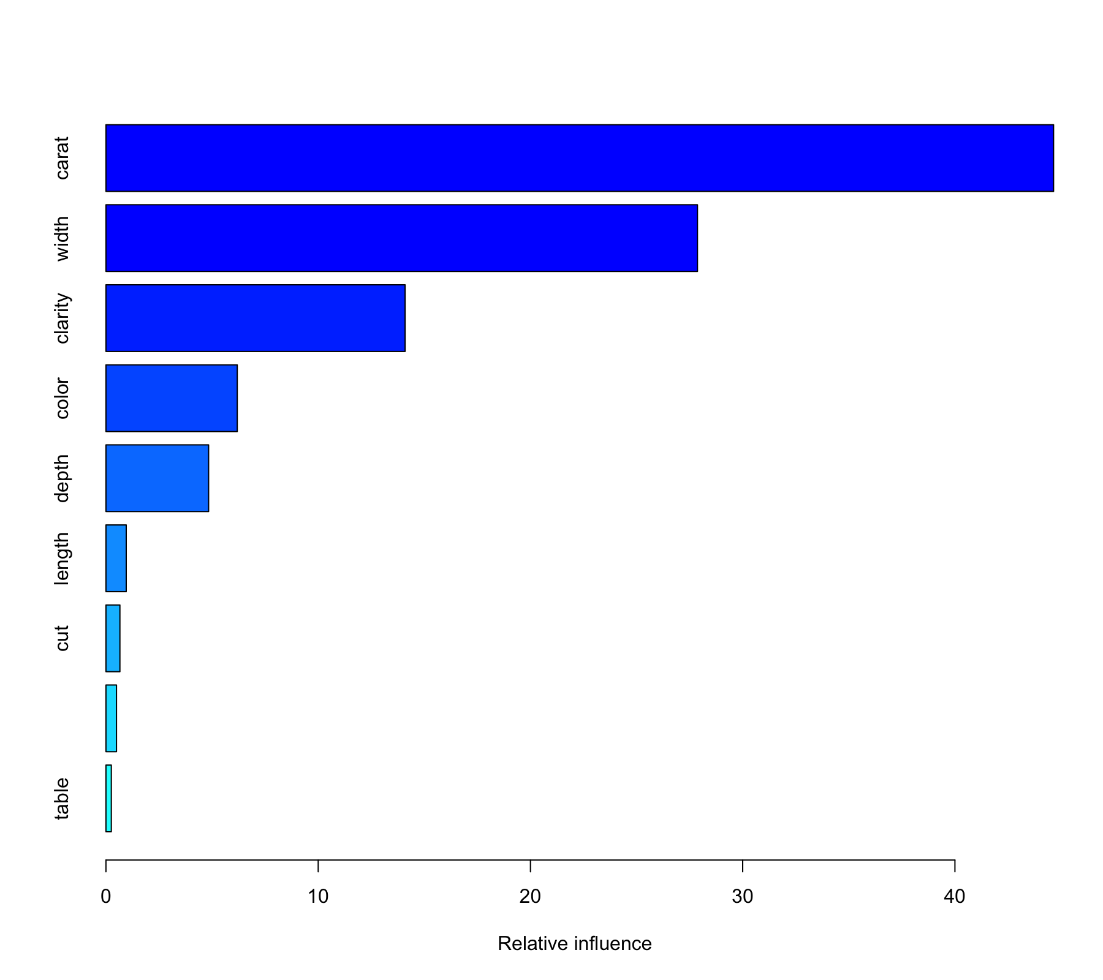
boosting
Boosting performed with 5000 trees with lambda = 0.02
The graph shows the importance of the variables
Best test RMSE obtained
Test RMSE
0.3850

Slide 35
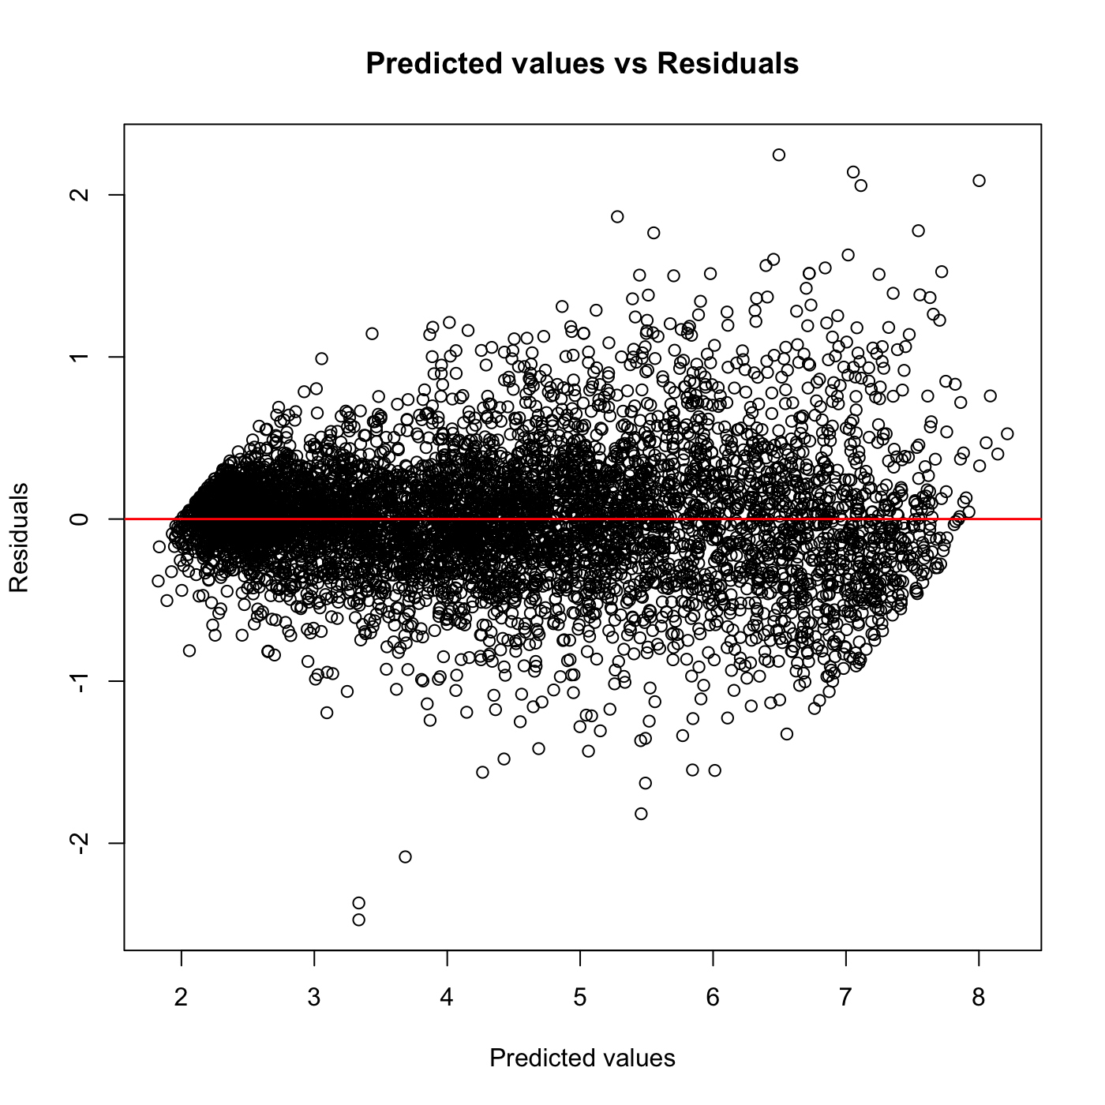
boosting
The graph shows how more accurate are the predictions compared with the linear models.

Slide 36
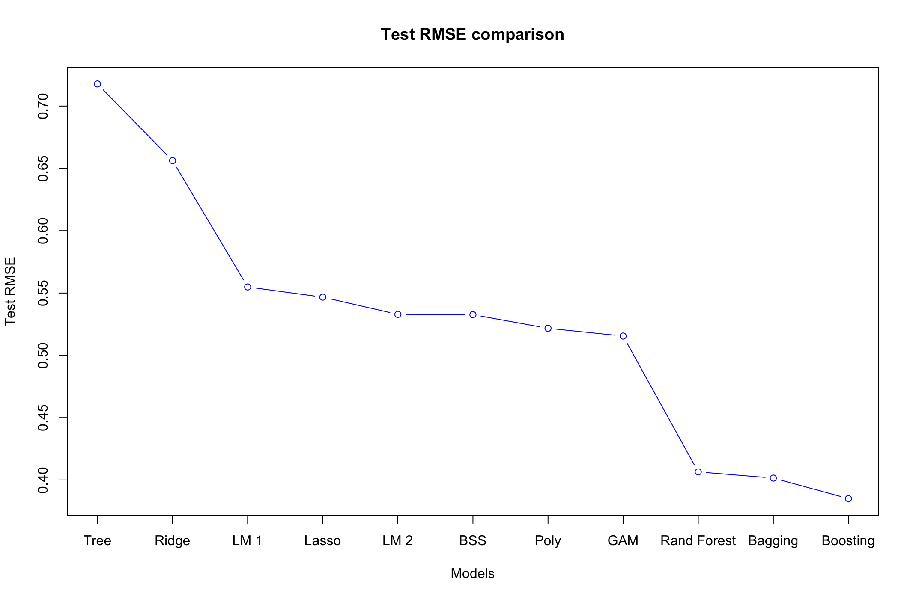
conclusions
The graph shows the different Test RMSE obtained for each model.

Slide 37
conclusions
The best model is Boosting with an RMSE of 385 $
Nonlinear models perform significantly better than linear models.
The most significant variables to predict price are Carat, Clarity, Width and Color.

Slide 38
CLASSIFICATION
So far we have seen that cut, clarity and color have a significant impact on diamond price.
Smaller diamonds with high values ​​of these 3 variables can costing more than bigger diamonds.
Starting from the 3 categorical variables, for each observation we have created a new binary variable "quality" (High, Low), a diamond will have a "High" value only if it simultaneously presents high values ​​of cut, color, clarity.

Slide 39
CLASSIFICATION GOALS
Starting from remaining regressor (carat, price, dept%, table%, width, length, depth), correctly predict whether a diamond belongs to the "High" or "Low" class.
Which predictors have the greatest impact on classification?
What is the boundary (linear,radial or polynomial) that separete the two classes?

Slide 40
PREPROCESSING STEPS
Creation of the new "quality" variable starting from the categorical variables color, cut, clarity.
Since the 2 classes are strongly unbalanced towards low, we apply an undersampling technique with ovun.sample().
The final dataset has 6.037 entry.
Splitting dataset in training set and test set (70%-30%).

Slide 41
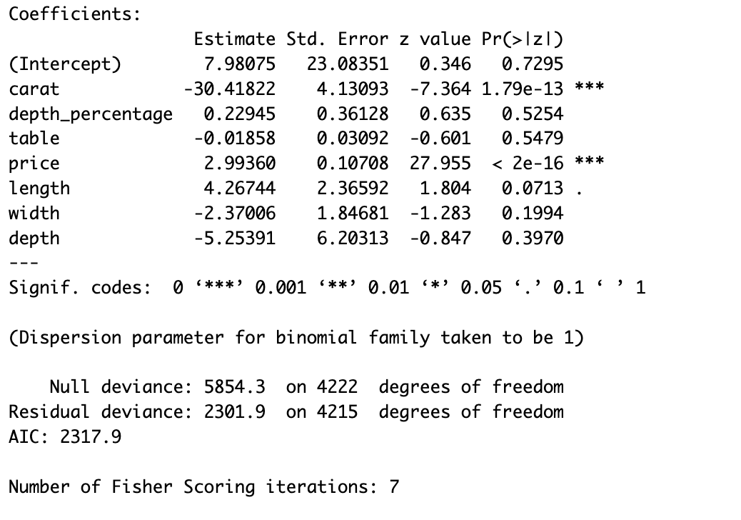
LOGISTIC REGRESSION
The only significant coefficients are carat and price.
Inserire tabella con confusion matrix.
Accuracy
89.06%

Slide 42
KNN
Since dataset still has a lot of observations, we use k-Nearest Neighbors.
In order to find the best k, we have used a 10-fold cross-validation approach.
The best is k = 5.
KNN performs worse than logistic regression.
Inserire confusion matrix.
Accuracy
86.52%

Slide 43
SUPPORT VECTOR MACHINES
SVM with linear kernel.
To find the best cost parameter, we have implemented cross-validation with tune().
The best cost is 5.
Aggiungere tabella confusion matrix.
Accuracy
89.50%

Slide 44
SUPPORT VECTOR MACHINES
SVM with radial kernel.
To find the best cost and gamma, we have implemented cross-validation with tune().
The best parameters are cost = 5 and gamma = 0.5.
Inserire confusion matrix.
Accuracy
90.00%

Slide 45
SUPPORT VECTOR MACHINES
SVM with polynomial kernel.
Better result with degree = 3 , cost = 5 and gamma = 0.5.
The model perform worse than previous.
Inserire confusion matrix.
Accuracy
87.96%

Slide 46
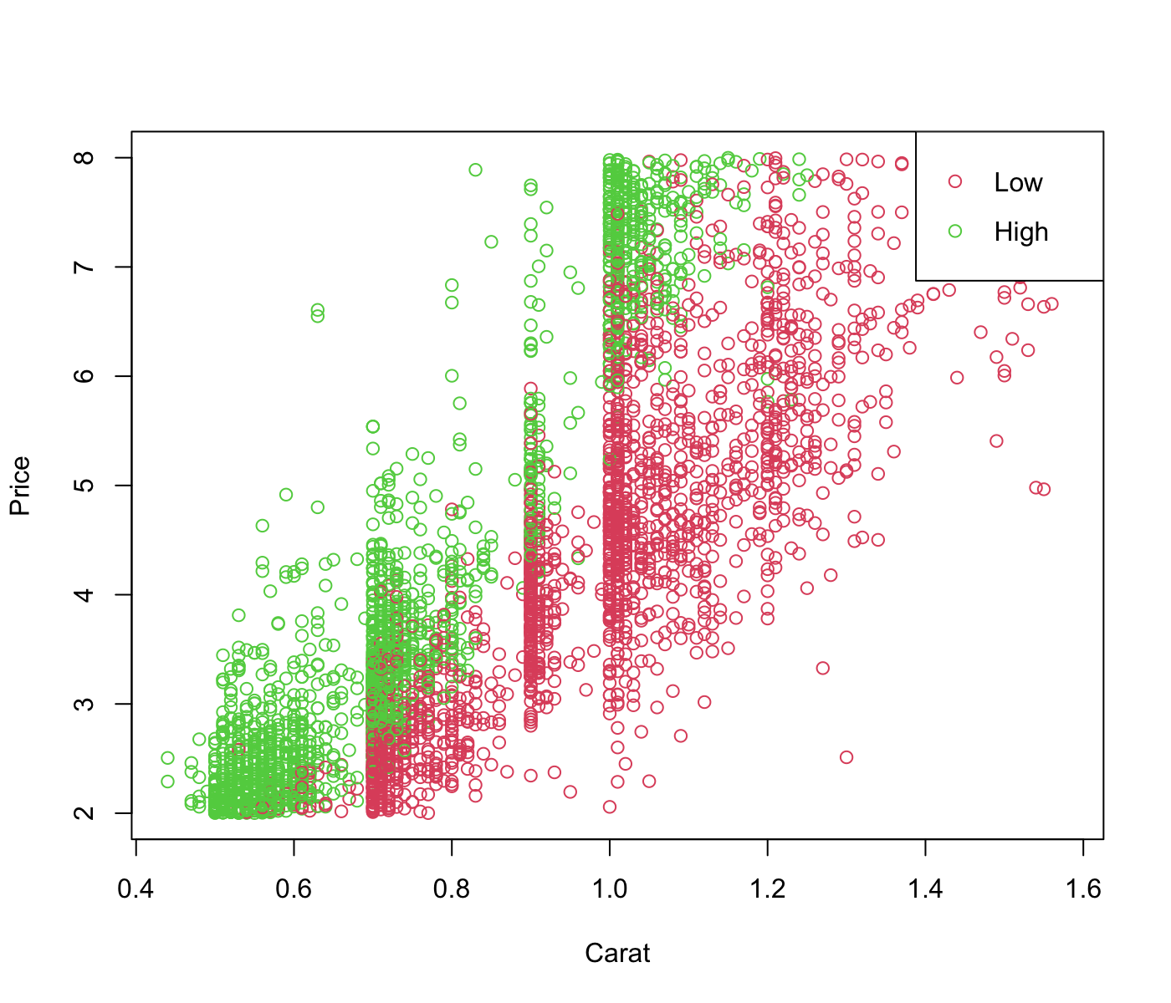
SUPPORT VECTOR MACHINES
We have seen from Logistic Regression that Carat and Price are the most significant variables.
Can an SVM model with just these two predictors correct classify diamonds?
Is linear kernel enough precise?

Slide 47

SUPPORT VECTOR MACHINES
The SVM model works better compared to linear SVM with all predictors.
The linear kernel is enough precise, we don’t need radial or polynomial kernel.
Inserire confusion matrix.
Accuracy
89.61%

Slide 48
CONCLUSIONS
The more importants predictors to correct classify diamonds are price and carat.
SVM models with linear boundaries are sufficiently accurate.

Slide 49
Thank you for the attention!

